Slide 1
ABOUT COMPANY
ATESY®
Production of professional kitchen equipment for public catering facilities since 1992
A
APEX
T
APEX
TECHNOLOGICAL
E
OF TECHNOLOGICAL
S
SYSTEMS
Y
SYSTEMS

Slide 2
ABOUT COMPANY
ATESY®
OUR MAIN CONSUMERS
Kindergartens
Schools
Secondary and higher education institutions
Hospitals
Sanatoria
Hotels
MoD entities
Restaurants, cafes, bars
Shops
and other public catering establishments and retail facilities

Slide 3

ABOUT COMPANY
ATESY®
We actively cooperate with scientific and non-profit institutions
Research Institute of Baby Food
of Russian Agricultural Academy
Bauman
Moscow State Technical University
Federal State Budgetary
Institution "Research
Institute of Nutrition"
of the Russian Academy
of Medical Sciences
Plekhanov
Russian University of Economics
State Research Institute of
baking industry
Center for
Revivals
of Traditions

Slide 4












ATESY®
ABOUT COMPANY
The quality of Atesy products is trusted by:
Notes:
4

Slide 5

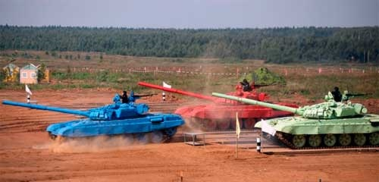


ATESY®
ABOUT COMPANY
MACHINE-BUILDING ENTERPRISE "ATESY" was involved in equipping food units at world-class events
G-20 summit in Saint Petersburg in 2013
World Cup "Tank biathlon-2014"
Winter Olympics in Sochi in 2014
FIFA World Cup 2018
Notes:
5

Slide 6
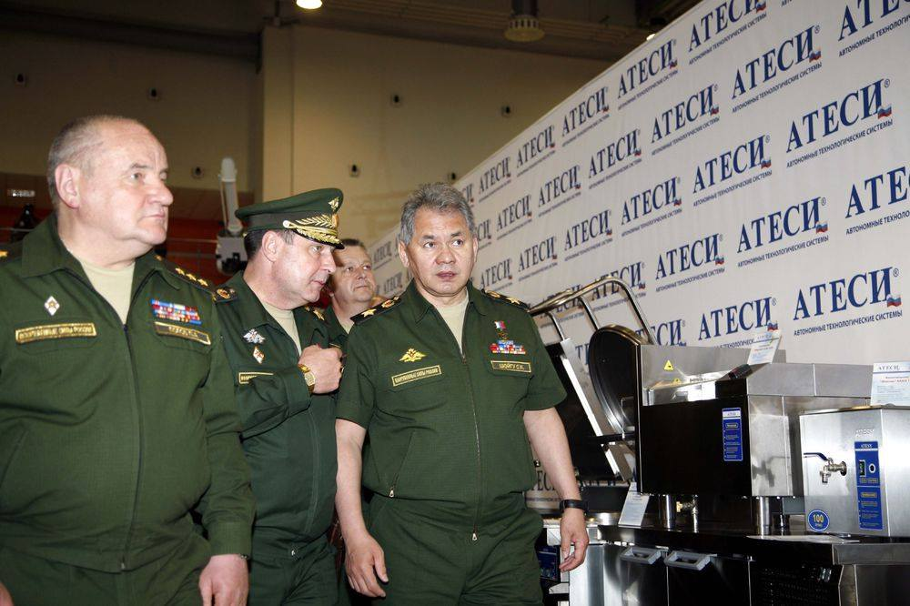
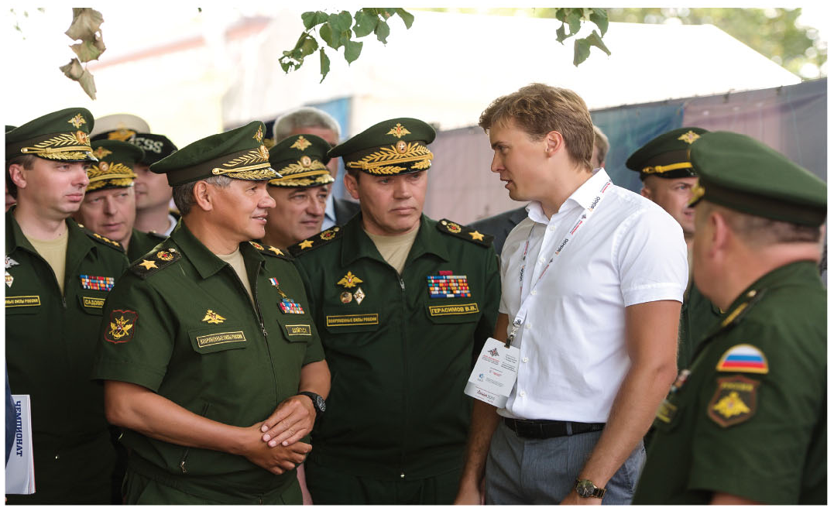
ABOUT COMPANY
ATESY®
MACHINE-BUILDING ENTERPRISE "ATESY" is an accredited supplier of the Ministry of Defense of the Russian Federation

Slide 7
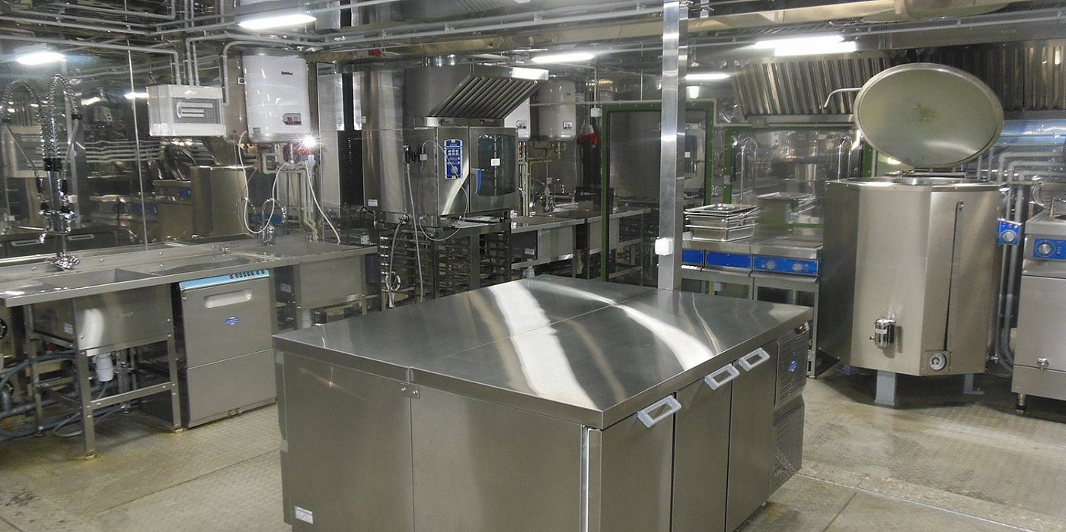
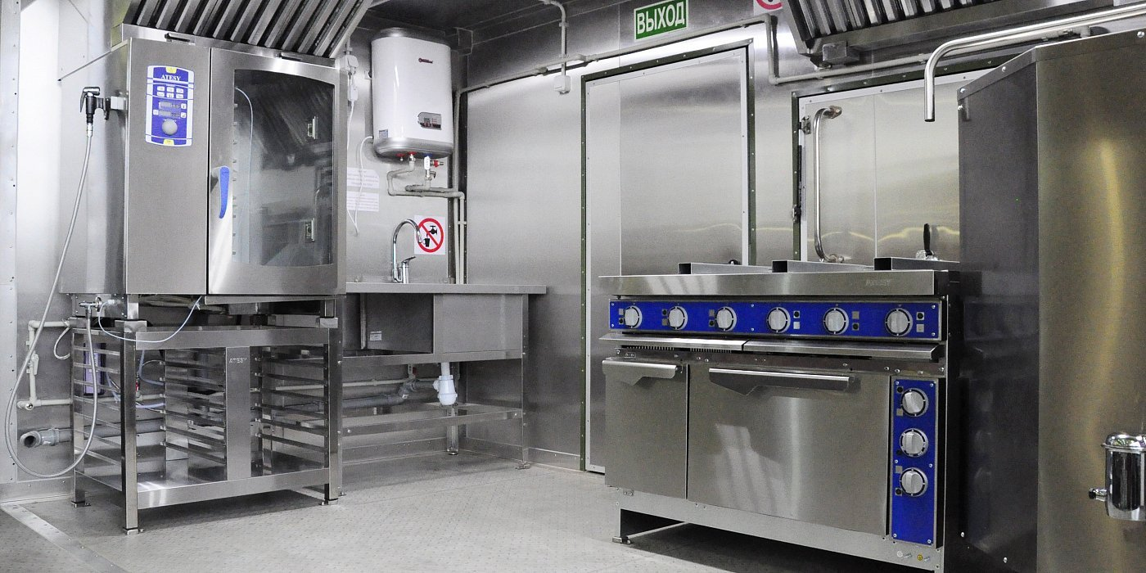
ABOUT COMPANY
ATESY®
From 2014 to 2017, ATESY equipped 18 Autonomous field camps on a turnkey basis for the Ministry of Defense of the Russian Federation, including in the Syrian Arab Republic

Slide 8
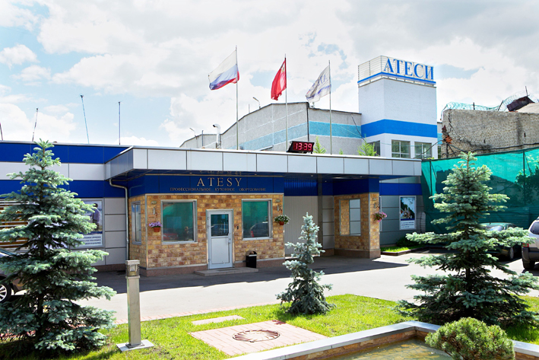
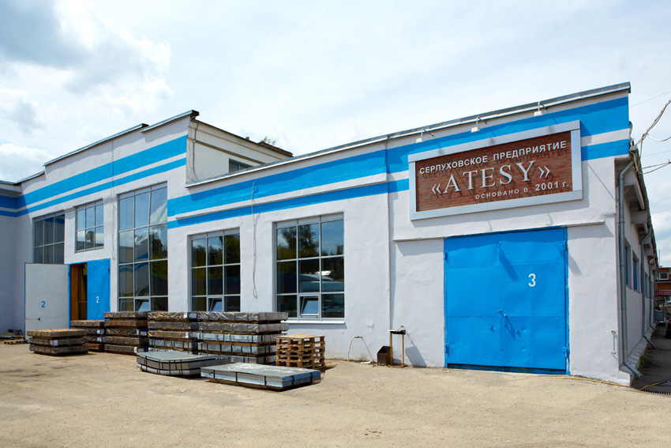
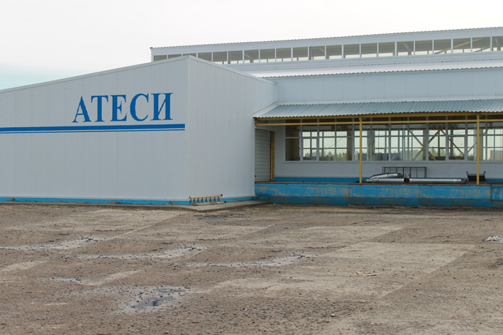
ABOUT COMPANY
ATESY®
Plants
ATESY-Lyubertsy
ATESY-Serpukhov
ATESY-Tambov
The total production area is 25 000 m2
The total storage area is 4,500 m2
The total number of employees is 400 people

Slide 9
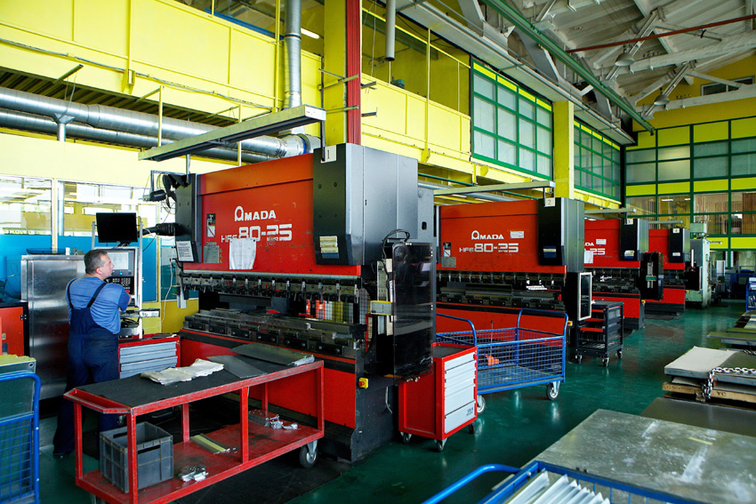
ABOUT COMPANY
ATESY®
Productive capacity
modern production equipment
qualified personnel

Slide 10
ATESY®
ABOUT COMPANY
Plant No. 1 in Moscow region. ATESY-Lyubertsy

Slide 11
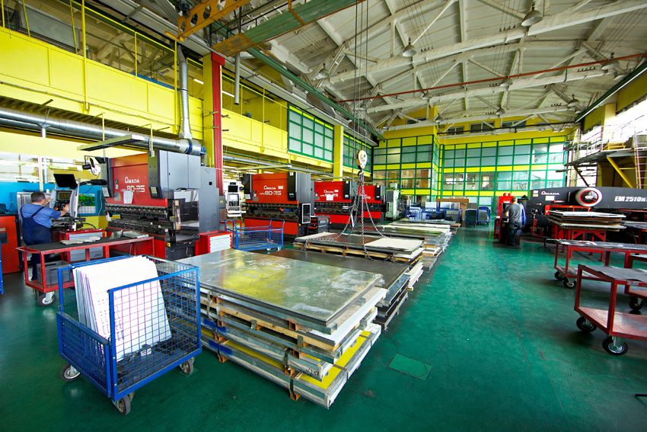
ATESY®
ABOUT COMPANY
ATESY production potential today. ATESY-Lyubertsy
The production area is 5 500 m2

Slide 12
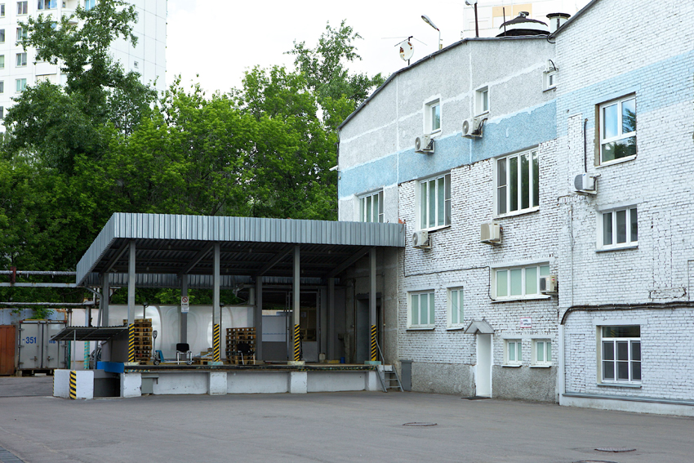
ATESY®
ABOUT COMPANY
ATESY production potential today. ATESY-Lyubertsy
Ramp of the shipping terminal.
The warehouse area is 1 500 m2

Slide 13
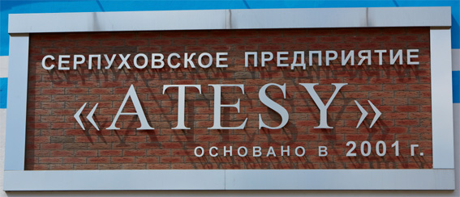
ATESY®
ABOUT COMPANY
Plant No. 2 in Moscow region. ATESY-Serpukhov

Slide 14
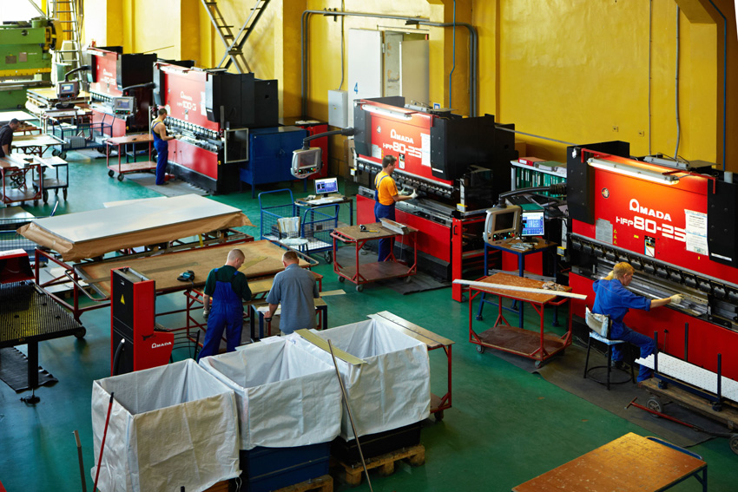
ATESY®
ABOUT COMPANY
ATESY production potential today. ATESY-Serpukhov
The production area is 9 500 m2

Slide 15
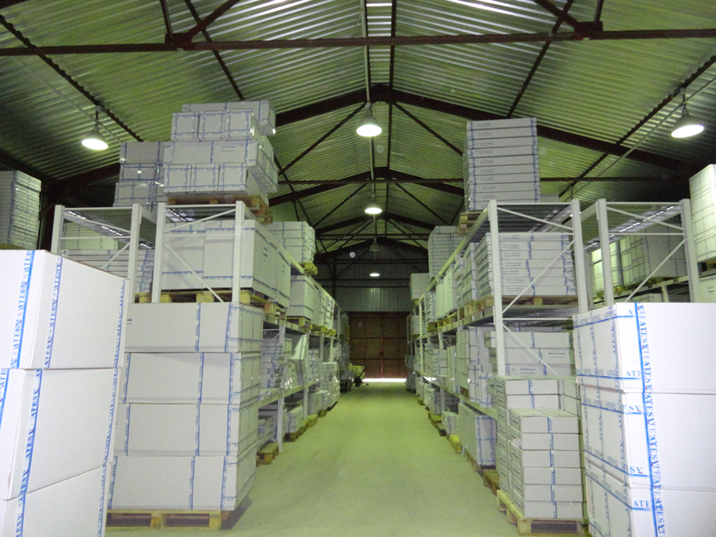
ATESY®
ABOUT COMPANY
ATESY production potential today. ATESY-Serpukhov
Warehouse of components and finished products.
The area of all warehouse complexes is 1,500 m2

Slide 16
ATESY®
ABOUT COMPANY
Plant No. 3 in Tambov. ATESY-Tambov

Slide 17
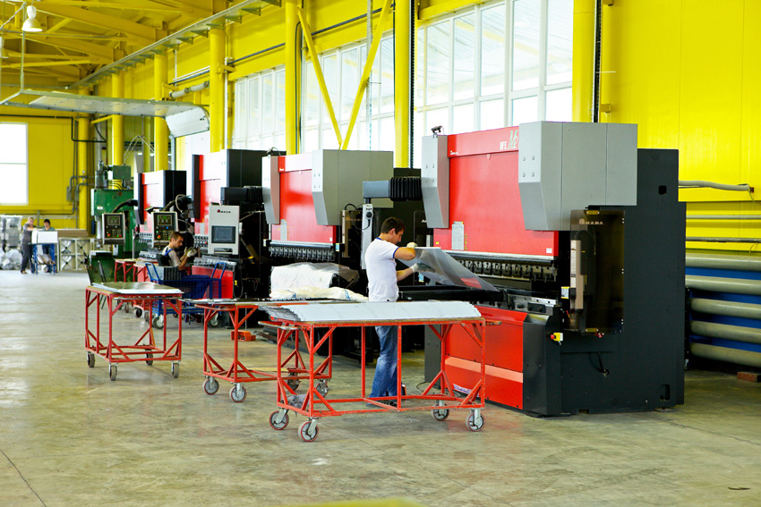
ATESY®
ABOUT COMPANY
ATESY production potential today. ATESY-Tambov
The production area is 5 500 m2

Slide 18
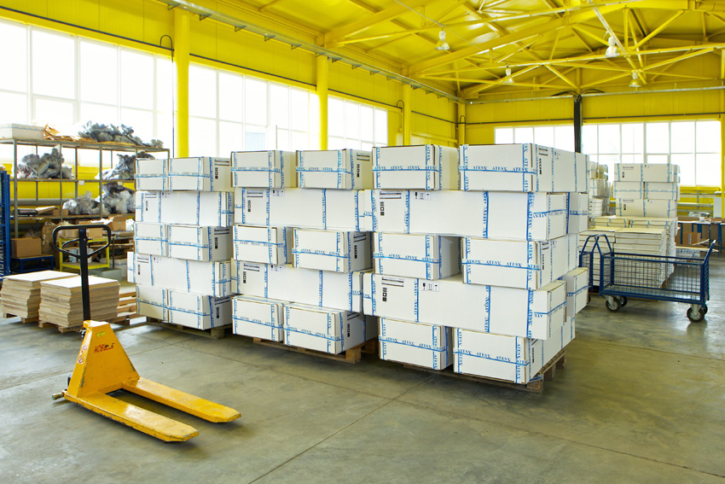
ATESY®
ABOUT COMPANY
ATESY production potential today. ATESY-Tambov
The storage area is 1 500 m2

Slide 19

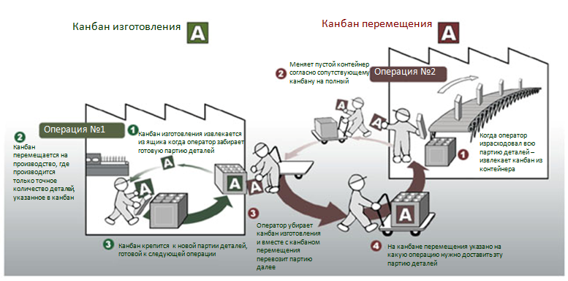
ATESY®
ABOUT COMPANY
All ATESY enterprises have implemented the principle of lean production
TPS - TOYOTA PRODUCTION SYSTEM

Slide 20
ABOUT COMPANY
ATESY®
Output of products
More than 500 types of products
11 product groups
10,000 products per month
1 billion rubles per annum.

Slide 21
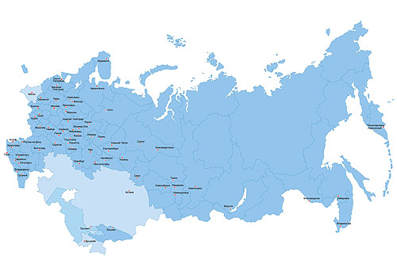
ABOUT COMPANY
ATESY®
Own network of service centers in Russia and the CIS
website WWW.ATESY.RU SERVICE section

Slide 22
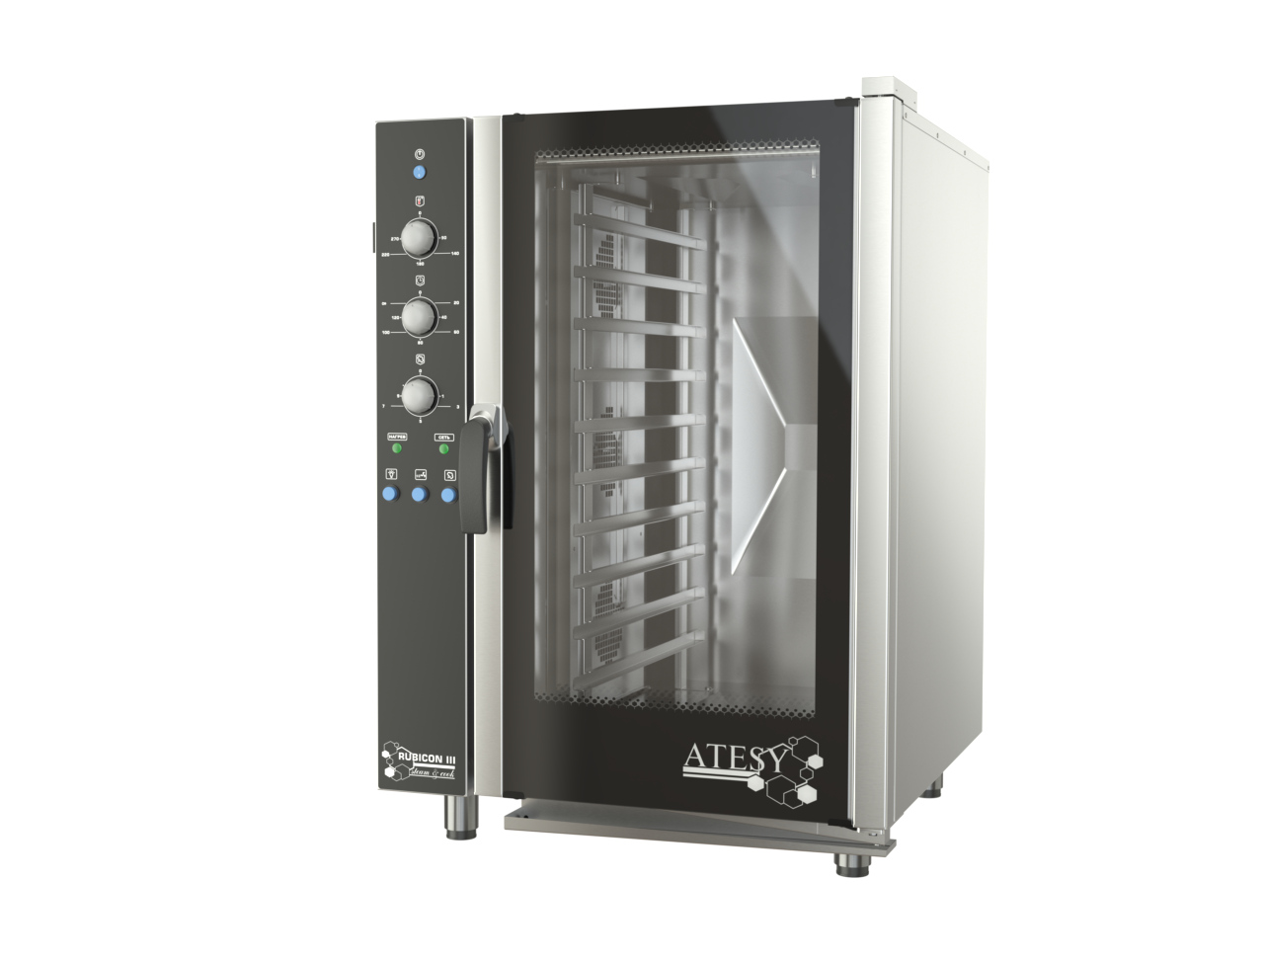
COMMODITY GROUPS
ATESY®
11 ATESY ASSORTMENT GROUPS
1. COMBI STEAMERS
2. POWER DISTRIBUTION LINES
3. THERMAL EQUIPMENT
4. EQUIPMENT FOR BAKERIES
5. FAST FOOD EQUIPMENT
6. READY-MADE SOLUTIONS FOR BUSINESS
7. REFRIGERATION AND BAR EQUIPMENT
8. ELECTROMECHANICAL EQUIPMENT
9. DISINFECTION AND CLEANING EQUIPMENT
10. VENTILATION EQUIPMENT
11. NEUTRAL EQUIPMENT

Slide 23

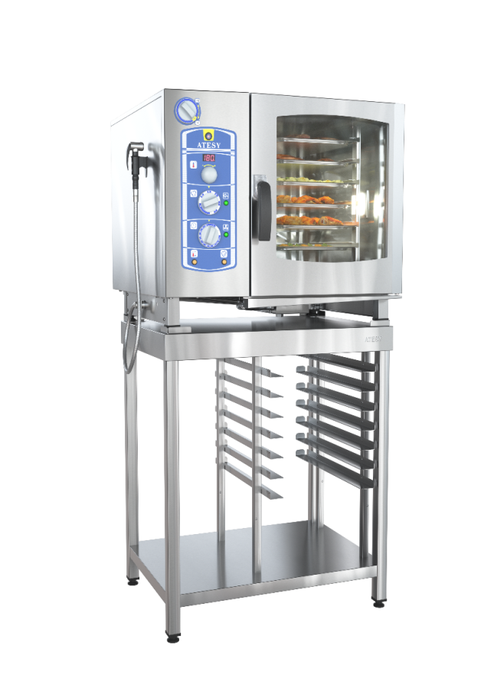
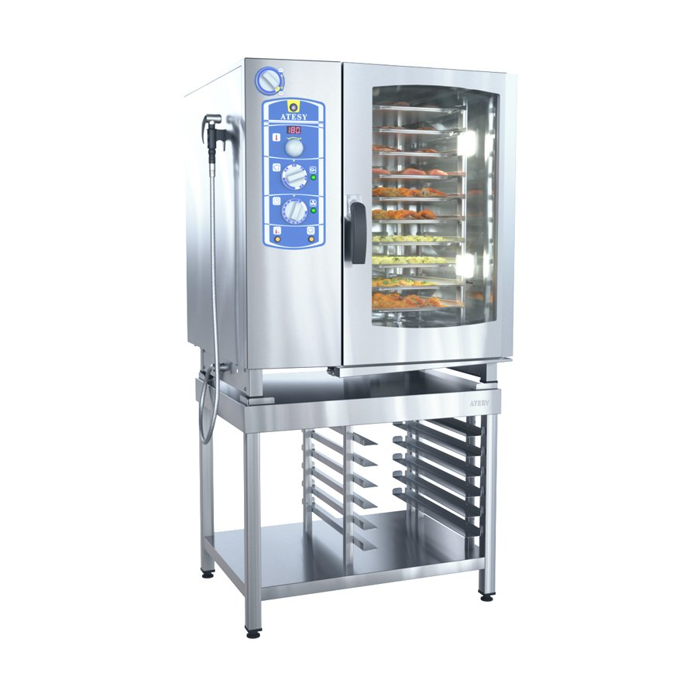
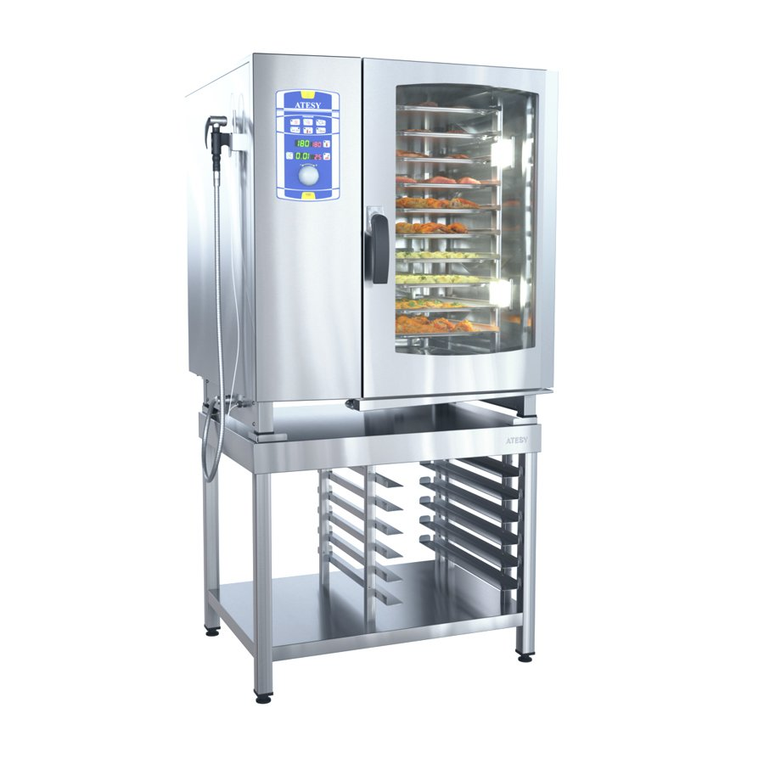
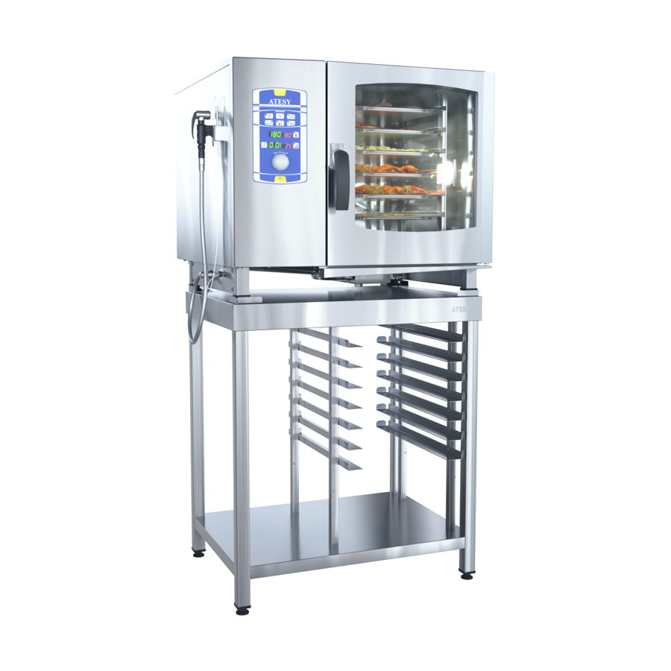
COMBI STEAMERS
ATESY®
COMBI STEAMERS RUBICON of the I-st GENERATION
simple and reliable operation
electromechanical control system
certified according to European CE standards
АПК-6-1/1
RUBICON
boiler
APK-10-1/1
RUBICON
boiler
АПК-6-1/1-И
RUBICON
injector
АПК-10-1/1-И
RUBICON
injector

Slide 24
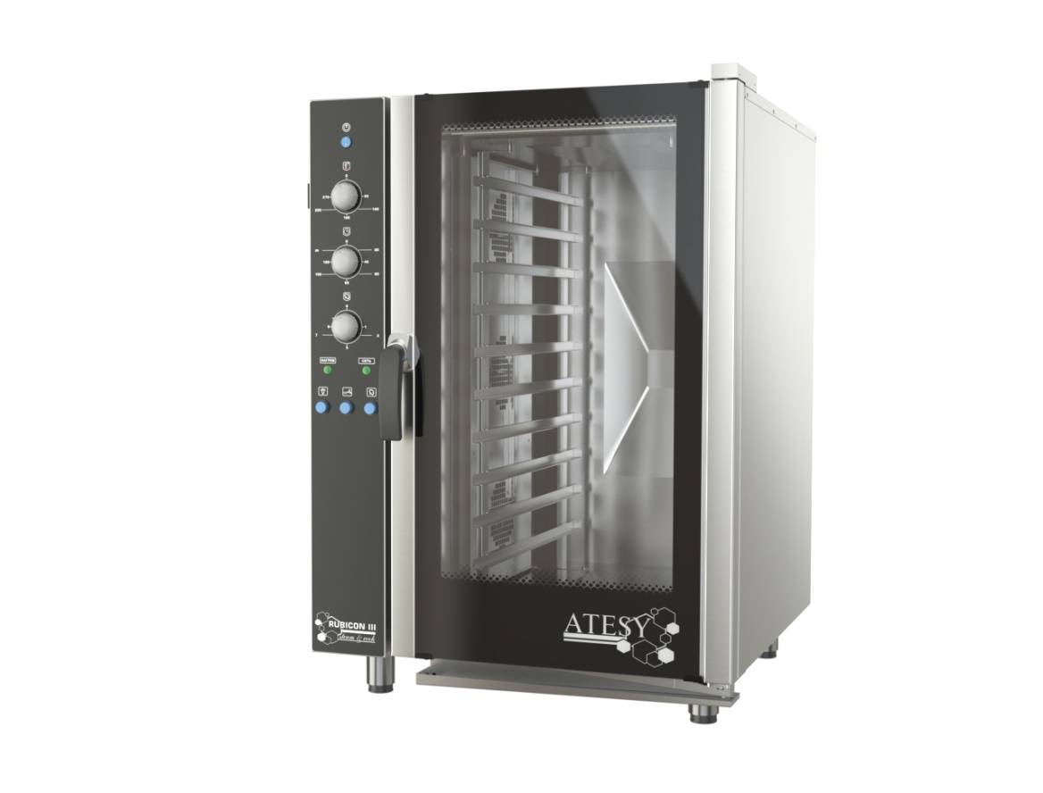
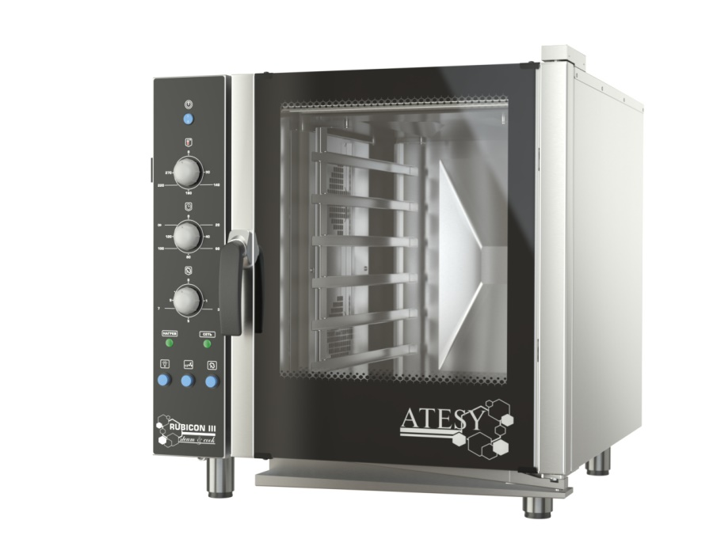
COMBI STEAMERS
ATESY®
Combi steamers of the III-rd generation “RUBIKON”
simple and reliable operation
steam injection system
electromechanical control system
certified according to European CE standards
АПК-6-1.1-03 injector
АПК-10-1.1-03 injector

Slide 25
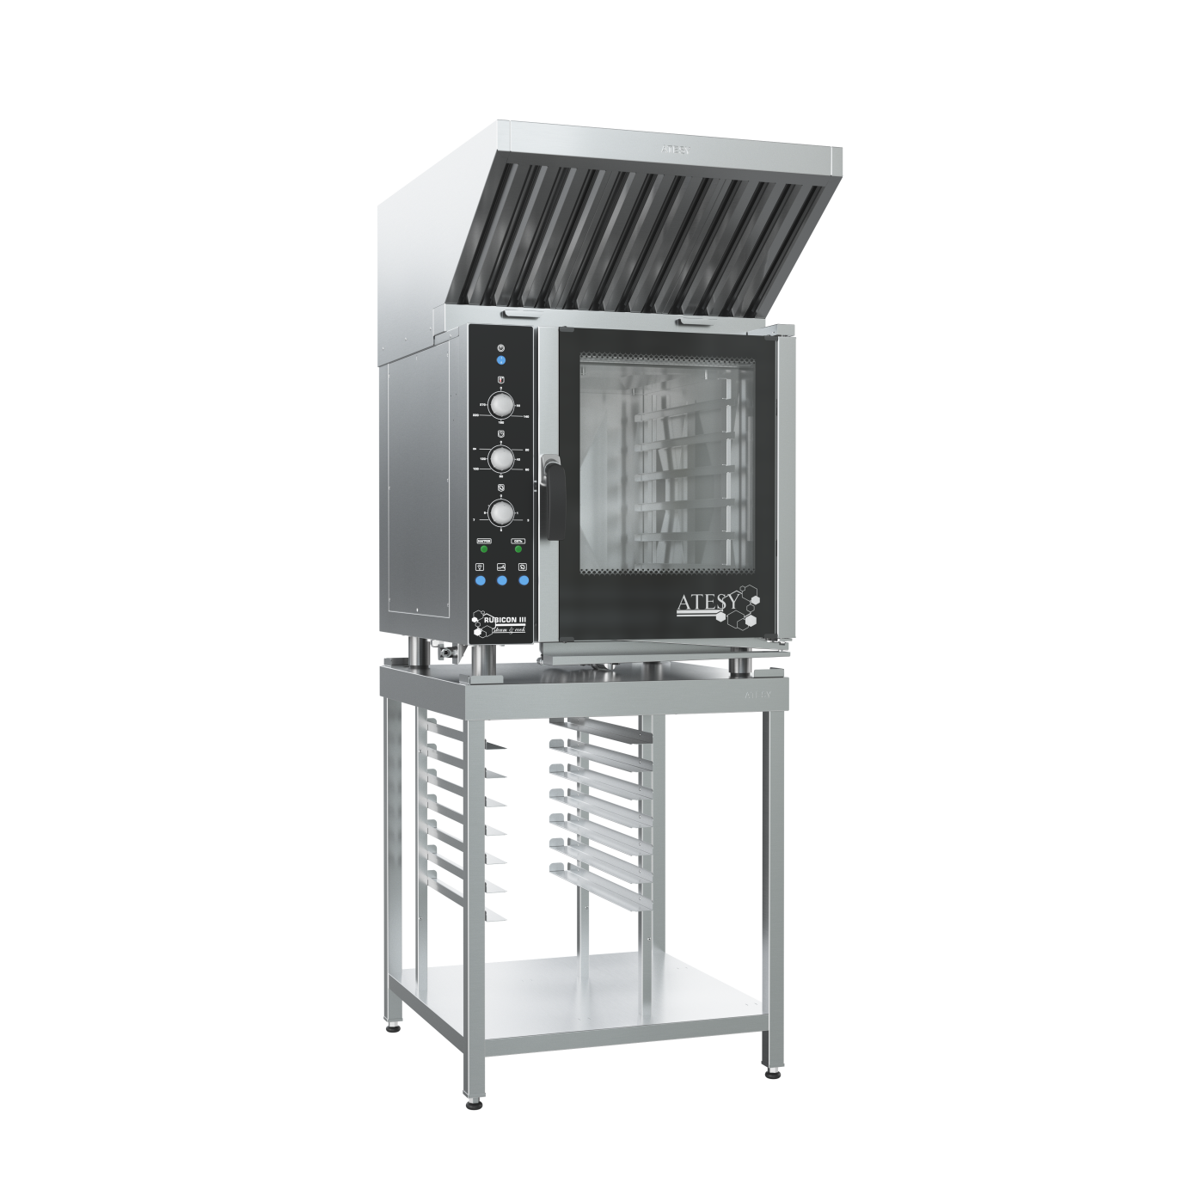
COMBI STEAMERS
ATESY®
Combi steamers of the III-rd generation “RUBIKON”
Built-in fan reverse function
Reduced fan speed function
(mode ½ )
Camera led light
Stylish modern design
Universal guides –
suitable for GN1/1 and 600x400 mm baking trays
The door lock has a "hands-free" function
AISI 304 mirror camera
Shower head with adjustable jet pressure

Slide 26


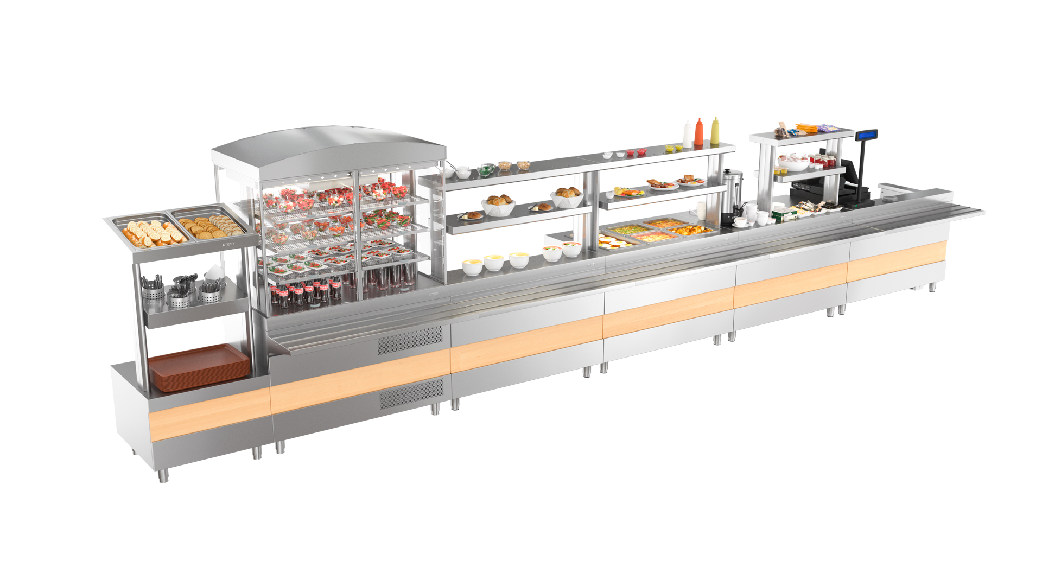
POWER DISTRIBUTION LINES
ATESY®
2-nd generation power distribution line
7
advantages
www.atesy.ru

Slide 27
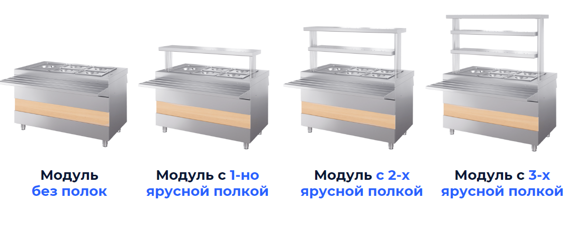
POWER DISTRIBUTION LINES
ATESY®
1
Modules are available to choose from
1, 2 or 3 tiered shelves
the shelf for the module is ordered additionally
www.atesy.ru

Slide 28
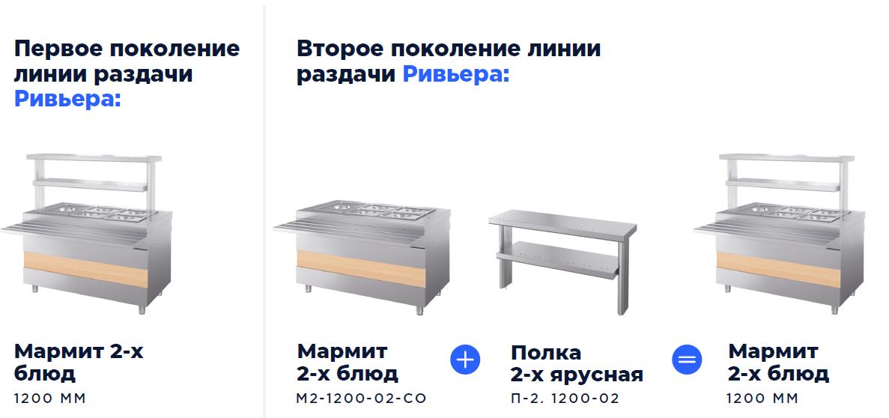
POWER DISTRIBUTION LINES
ATESY®
Example of completing a module with a shelf
BEFORE
AFTER
module length
1200 mm
shelf length
1200 mm
www.atesy.ru

Slide 29
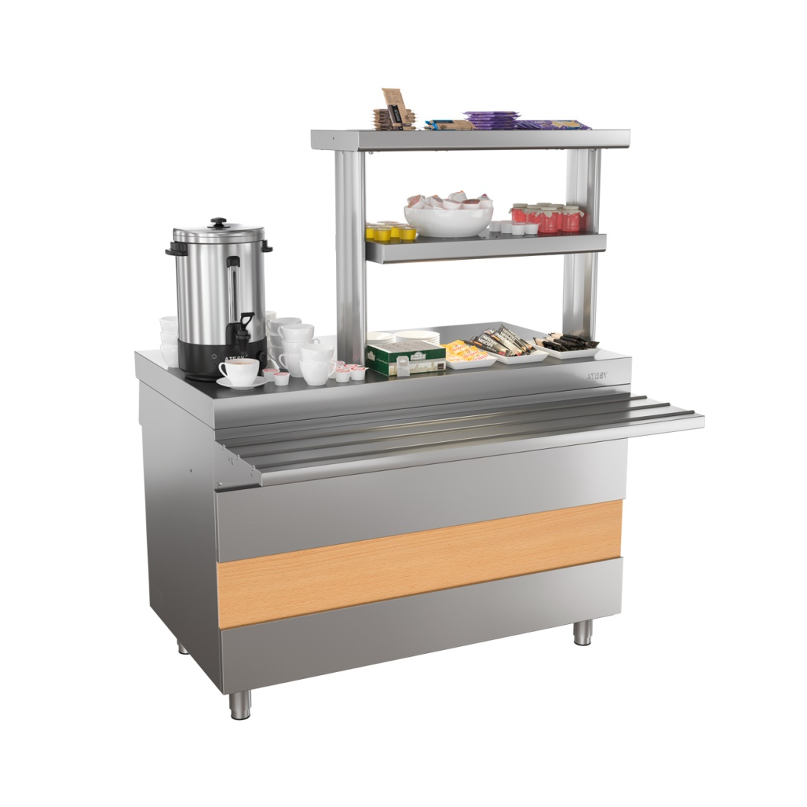
POWER DISTRIBUTION LINES
ATESY®
Length of a shelf for hot drinks counters
ПГН-1120-02-О
ПГН-1200-02-О
ПГН-1500-02-О
the shelf length is equal to 2/3 of the module length
www.atesy.ru

Slide 30
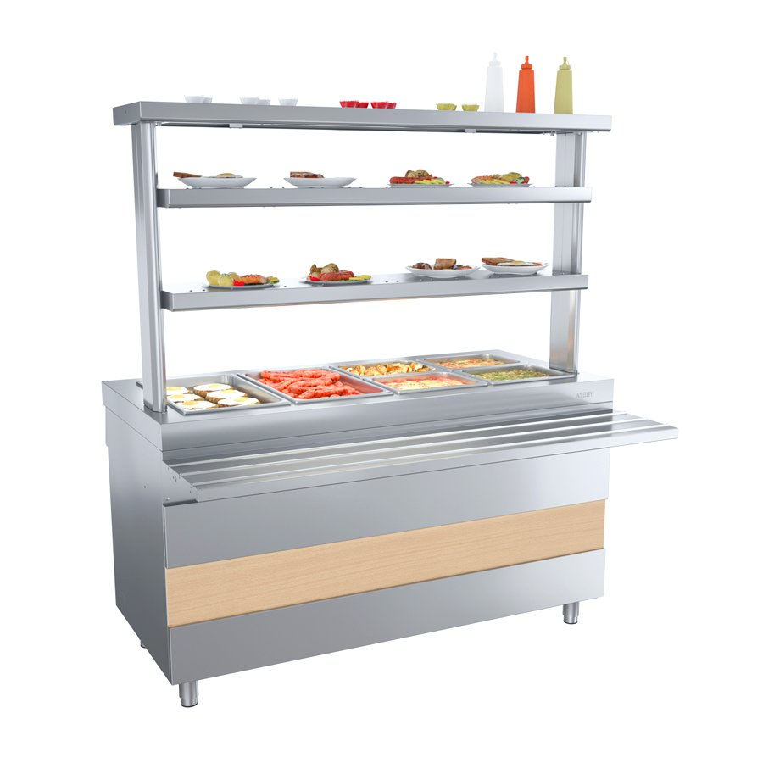
POWER DISTRIBUTION LINES
ATESY®
2
Unique guide slides
ensure smooth movement of trays
no vibrations or bumps
the guide slides of neighboring modules are bolted together
the guide slides have longitudinal convex elements that facilitate the sliding of trays
www.atesy.ru

Slide 31

POWER DISTRIBUTION LINES
ATESY®
3
Easily replaceable front panel
allows you to create the necessary interior
made to order with any design
standard equipment
«bleached oak»
any design to order
www.atesy.ru

Slide 32


POWER DISTRIBUTION LINES
ATESY®
4
Shelf lighting
illuminates dishes in modules, on 2 lower shelves and the front panel
made to order:
lamp for 2nd and 3rd level shelves
standard delivery:
shelf lamp
of 1st level
made to order:
front panel lighting
www.atesy.ru

Slide 33
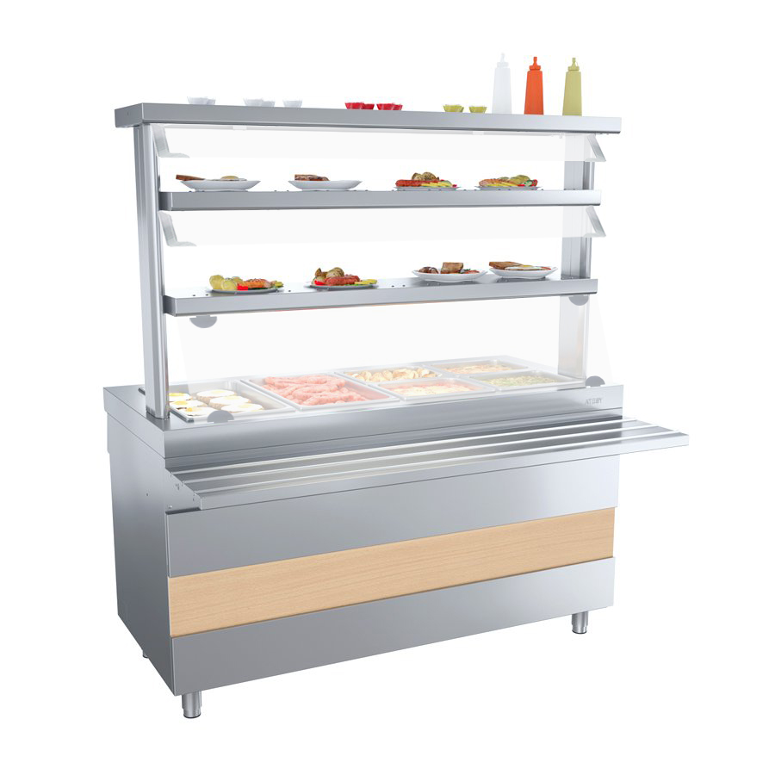
POWER DISTRIBUTION LINES
ATESY®
5
Protective windshields and visors
ensure the hygiene of food distribution
made to order:
shelf visor
of 2nd and 3rd tiers
made to order:
protective glass of the 1st tier shelf
www.atesy.ru

Slide 34
POWER DISTRIBUTION LINES
ATESY®
6
Wide size range of modules
allows you to select a line for any area
length of the modules
1 120 mm
1,200 mm
1,500 mm
www.atesy.ru

Slide 35
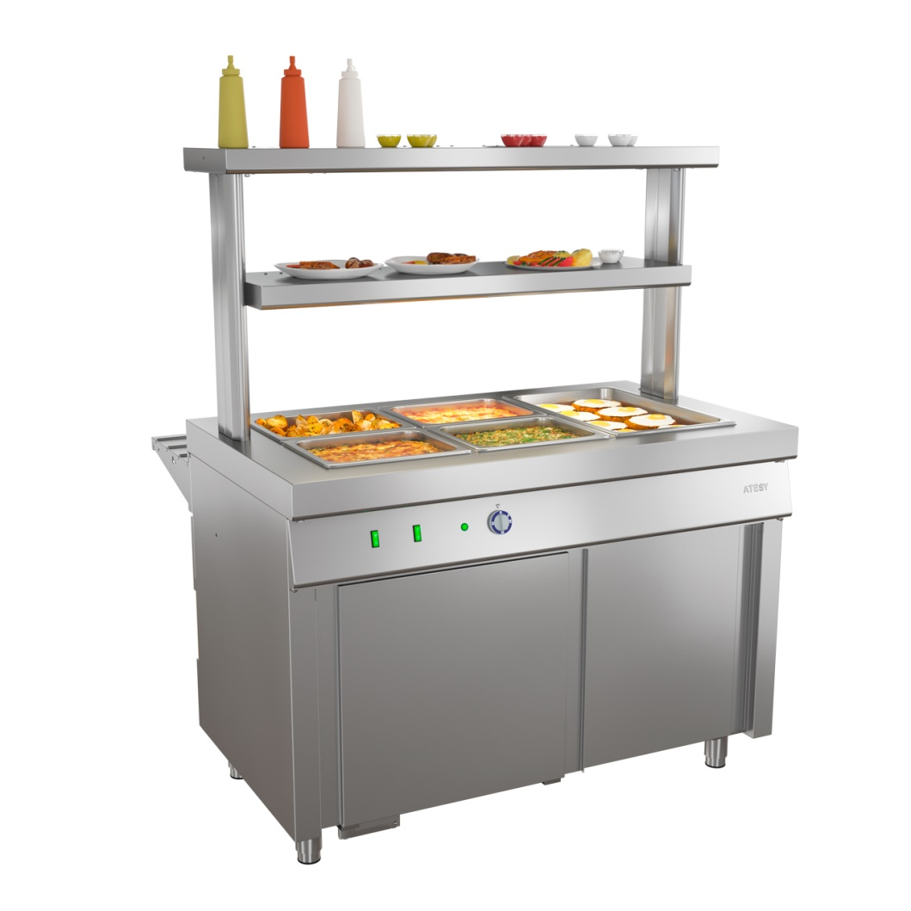
POWER DISTRIBUTION LINES
ATESY®
7
Efficient use of space
pocket door on the side of the service personnel
pocket door
www.atesy.ru

Slide 36
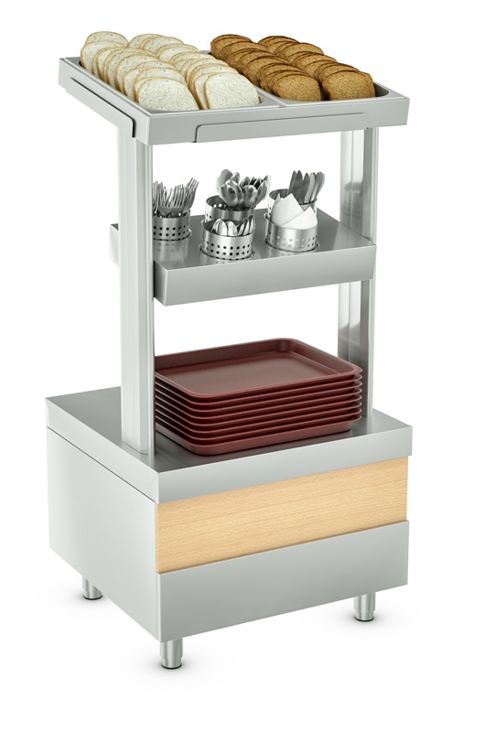
POWER DISTRIBUTION LINES
ATESY®
STAND FOR CUTLERY
СП- 700-02
shelf for two types of bread
5 storage sections:
- tablespoons
- teaspoons
- forks
- table knifes
- napkins
niche for storage of trays
www.atesy.ru

Slide 37
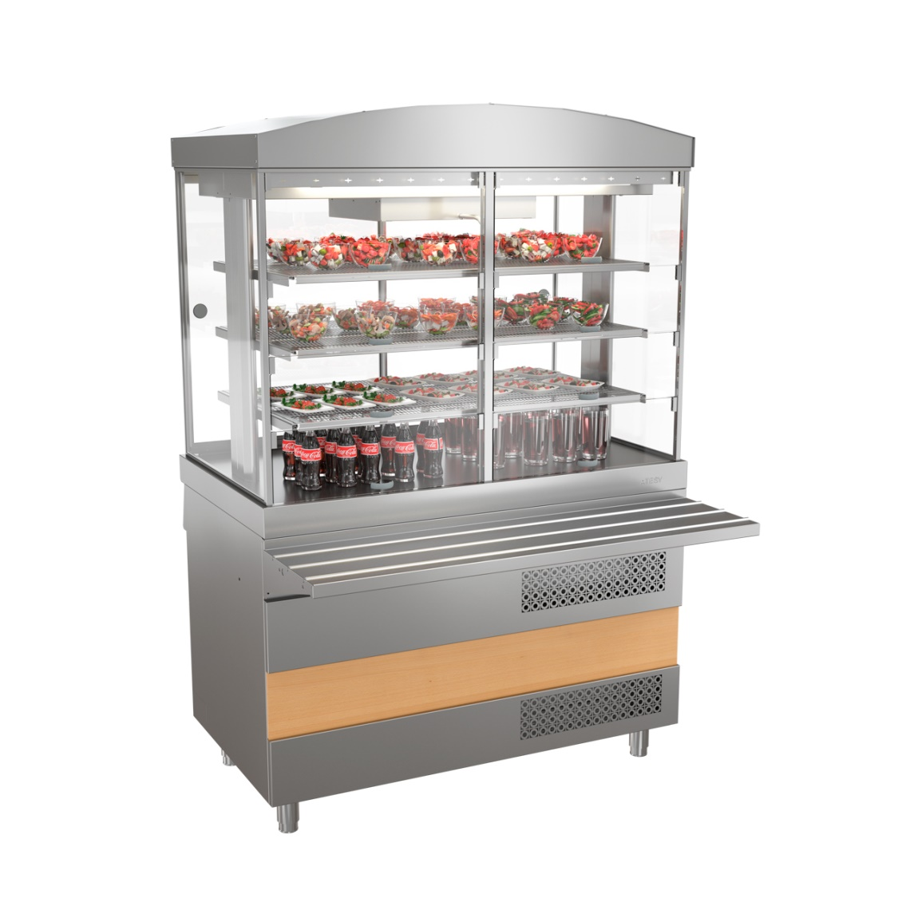
POWER DISTRIBUTION LINES
ATESY®
REFRIGERATED DISPLAY CASE
ХВ-1120-02
ХВ-1200-02
ХВ-1500-02
efficient dynamic cooling
temperature range +2 ... +6 °C
3 removable perforated shelves
high level of thermal insulation
customer-side doors with self-closing mechanism
internal volume lighting
operates from the mains 220 V, 50 Hz
www.atesy.ru

Slide 38
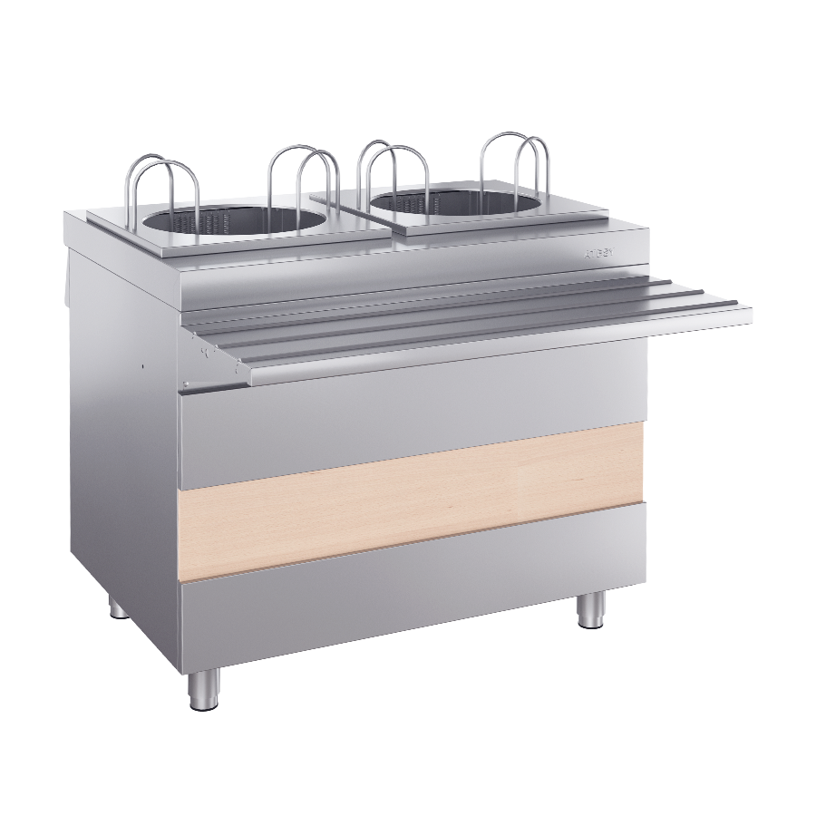
POWER DISTRIBUTION LINES
ATESY®
PLATE HEATING MODULE
МПТ-2. 950-02
capacity up to 90 plates
diameter of plates from 160 to 320 mm
operates from the mains 220 V, 50 Hz
www.atesy.ru

Slide 39
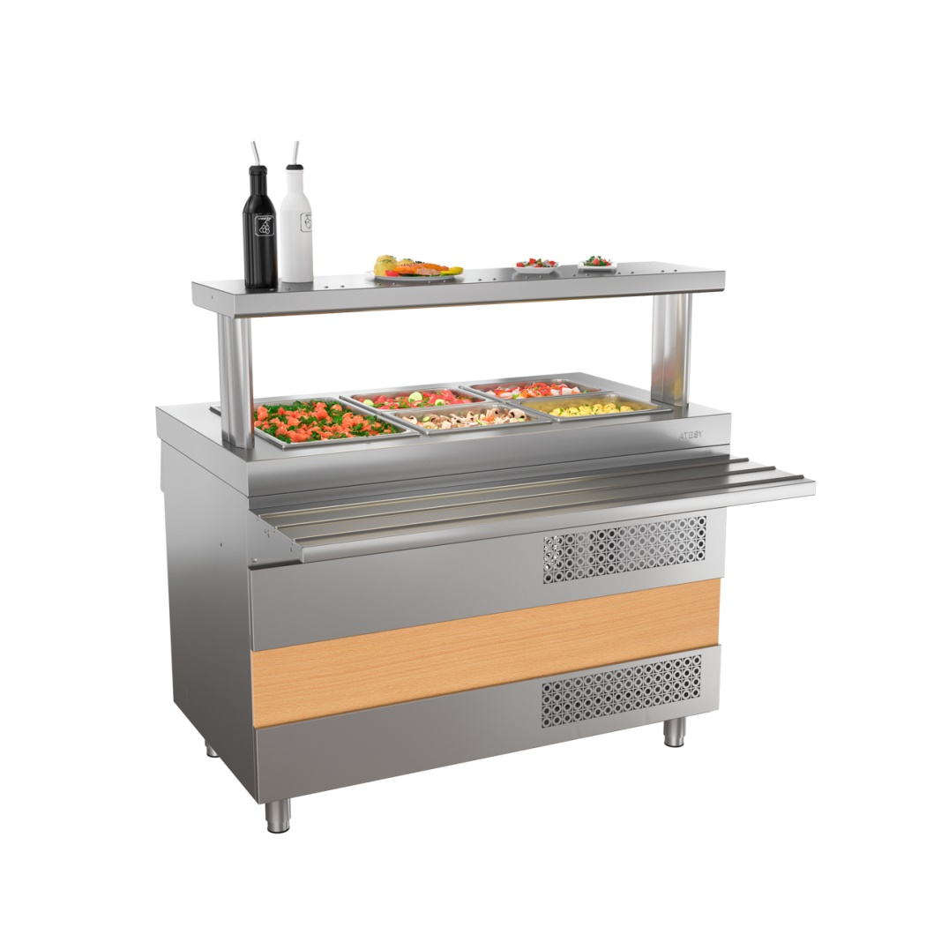
POWER DISTRIBUTION LINES
ATESY®
REFRIGERATED TABLE
ОС-1120-02-О
ОС-1200-02-О
ОС-1200-02
Gastronorm Vat 150mm deep
there is a сabinet with compartment doors under the table top
temperature range +2 ... +6 °C
operates from the mains 220 V, 50 Hz
www.atesy.ru

Slide 40
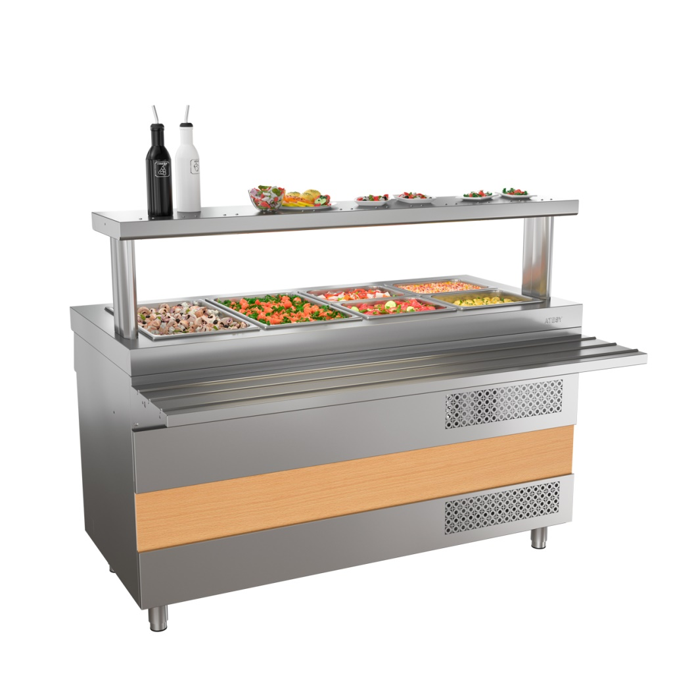
POWER DISTRIBUTION LINES
ATESY®
REFRIGERATED TABLE
ОС-1500-02-О
ОС-1500-02
Gastronorm Vat 150mm deep
there is a сabinet with compartment doors under the table top
temperature range +2 ... +6 °C
operates from the mains 220 V, 50 Hz
www.atesy.ru

Slide 41
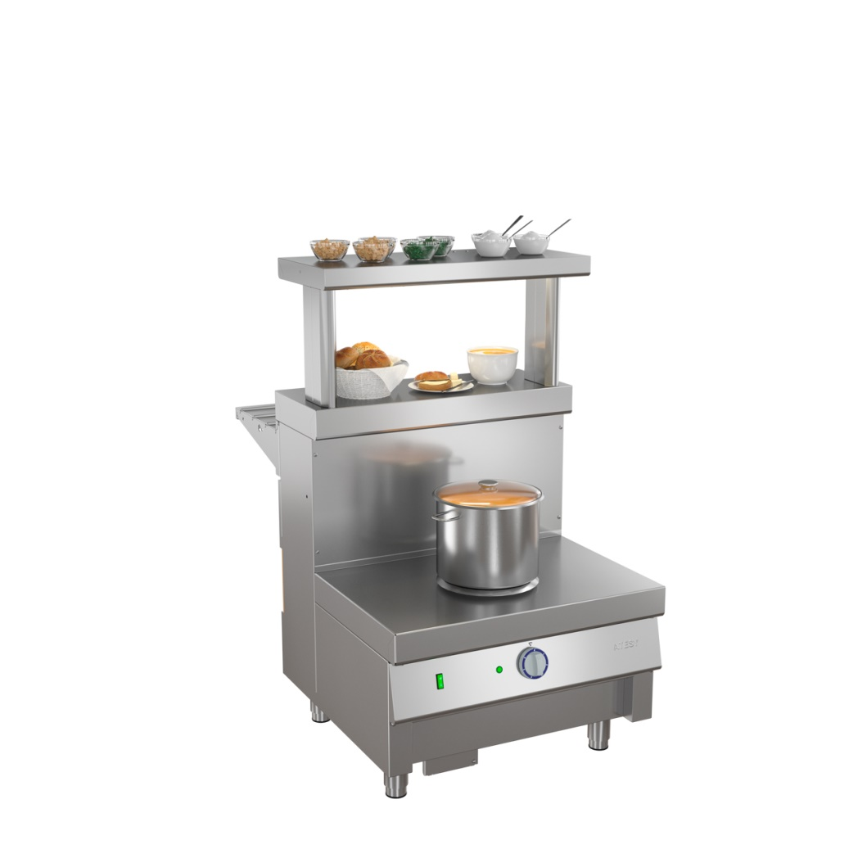
POWER DISTRIBUTION LINES
ATESY®
HOT FOOD UNIT FOR FIRST COURSES
М1-1.700-02-О
for pans and tanks up to 50 liters
six levels of power adjustment
operates from the mains 220 V, 50 Hz
www.atesy.ru

Slide 42
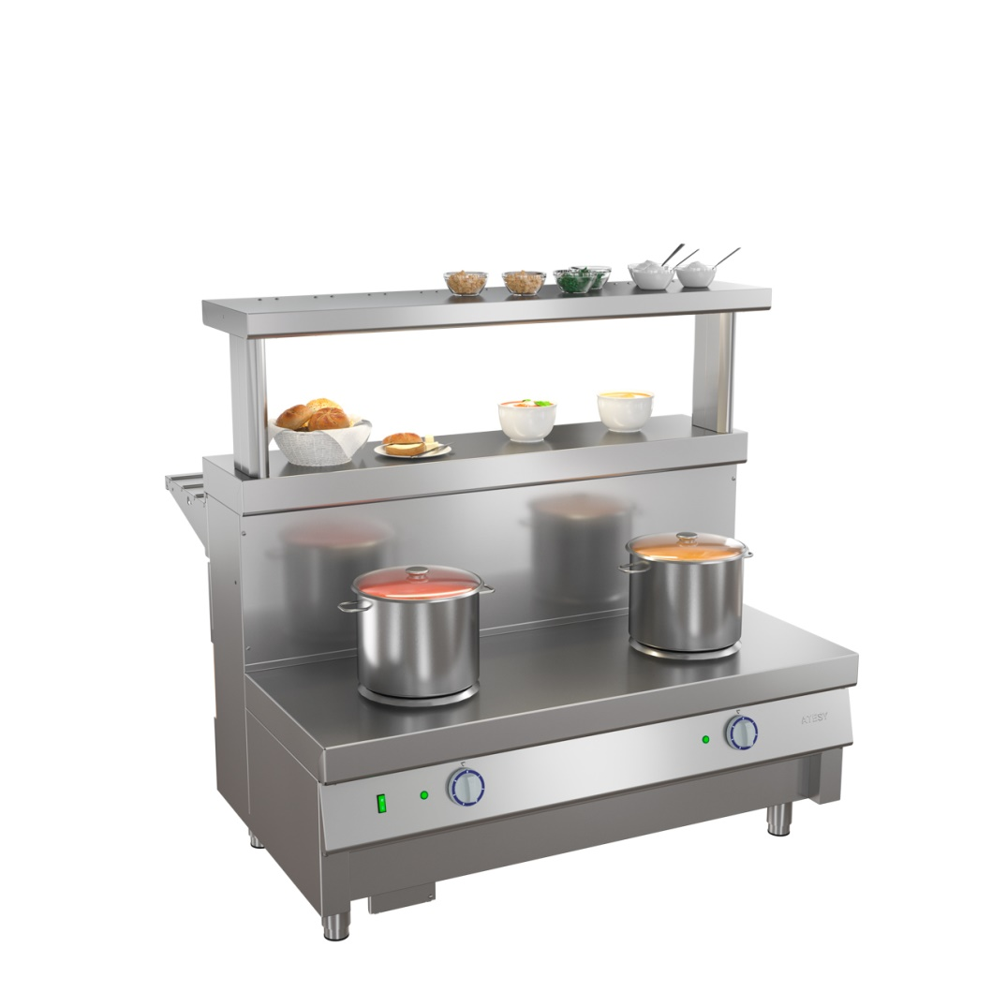
POWER DISTRIBUTION LINES
ATESY®
HOT FOOD UNIT FOR FIRST COURSES
М1-2.1120-02-О
М1-2.1200-02-О
for pans and tanks up to 50 liters
six levels of power adjustment
operates from the mains 220 V, 50 Hz
www.atesy.ru

Slide 43
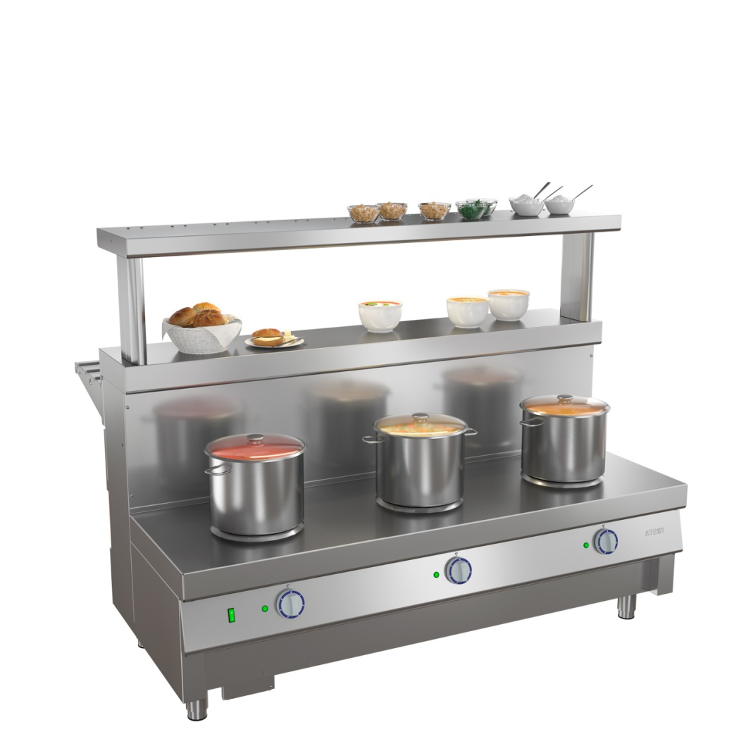
POWER DISTRIBUTION LINES
ATESY®
HOT FOOD UNIT FOR FIRST COURSES
М1-3.1500-02-О
for pans and tanks up to 50 liters
six levels of power adjustment
operates from the mains 220 V, 50 Hz
www.atesy.ru

Slide 44
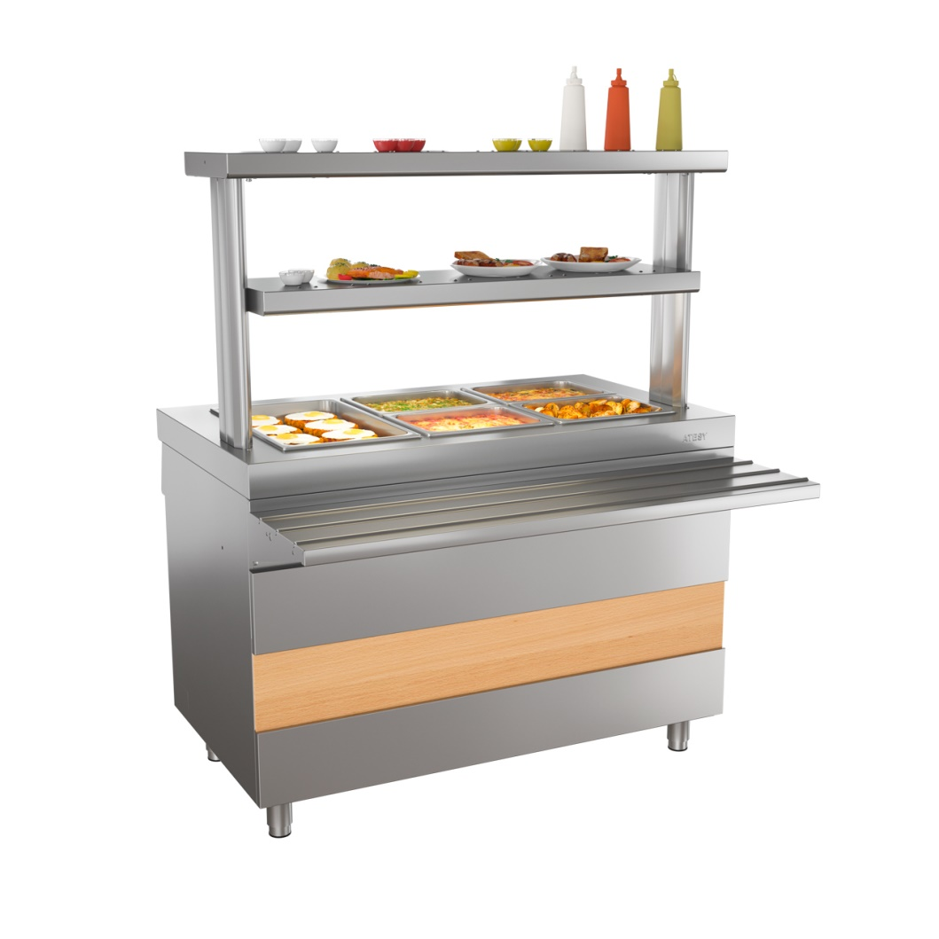
POWER DISTRIBUTION LINES
ATESY®
HOT FOOD UNIT FOR SECOND COURSES
М2-1120-02-ПО
М2-1120-02-СО
М2-1200-02-ПО
M2-1200-02-CO
gastronorm pans up to 150mm deep
there is a сabinet with compartment doors under the table top
two versions:
  dry heating
  steam heating
operates from the mains 220 V, 50 Hz
www.atesy.ru

Slide 45
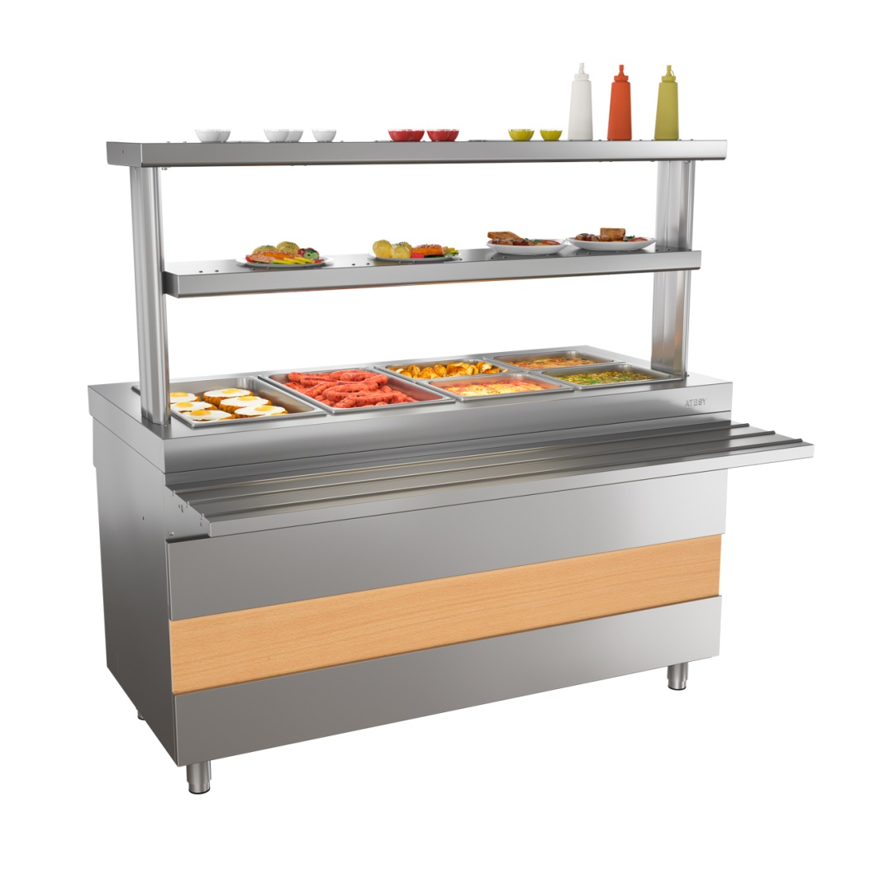
POWER DISTRIBUTION LINES
ATESY®
HOT FOOD UNIT FOR SECOND COURSES
М2-1500-02-ПО
М2-1500-02-СО
gastronorm pans up to 150mm deep
there is a сabinet with compartment doors under the table top
two versions:
  dry heating
  steam heating
operates from the mains 220 V, 50 Hz
www.atesy.ru

Slide 46
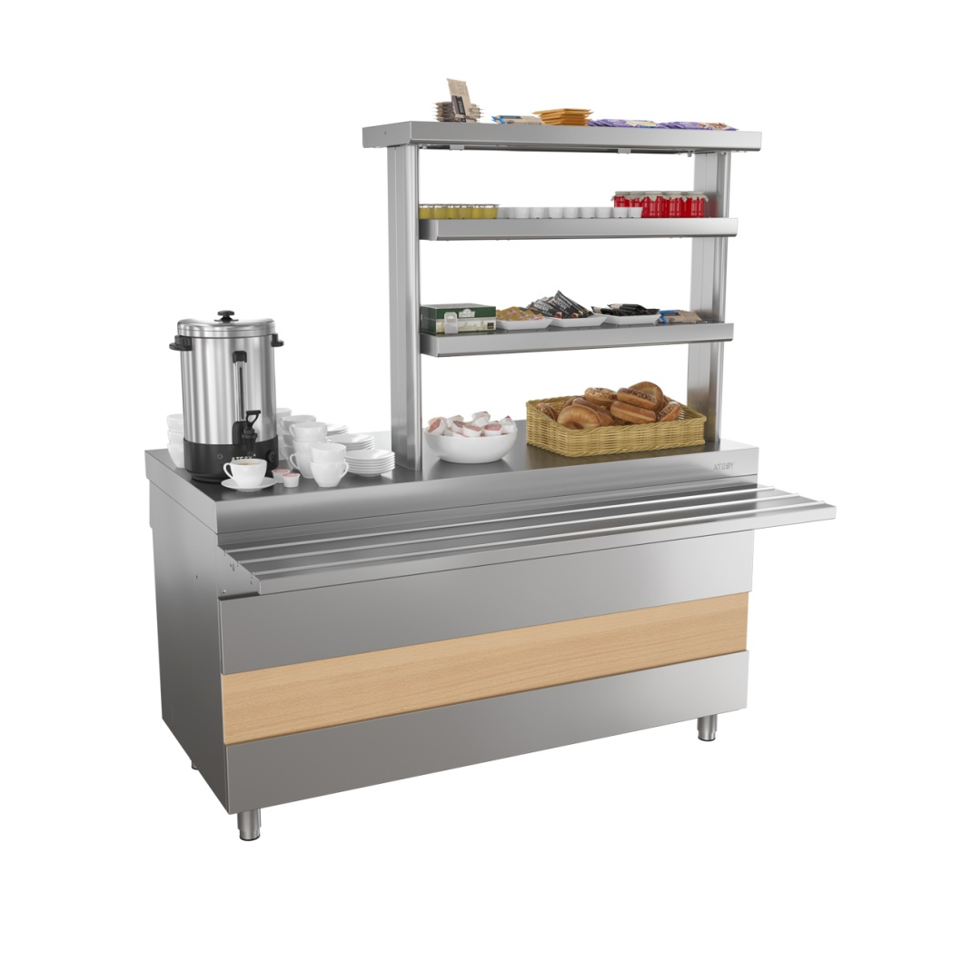
POWER DISTRIBUTION LINES
ATESY®
COUNTER FOR HOT DRINKS
ПГН-1120-02
ПГН-1120-02-О
ПГН-1200-02
ПГН-1200-02-О
ПГН-1500-02
ПГН-1500-02-О
shortened shelf
2 electrical outlets
there is a сabinet with compartment doors under the table top
operates from the mains 220 V, 50 Hz
www.atesy.ru

Slide 47
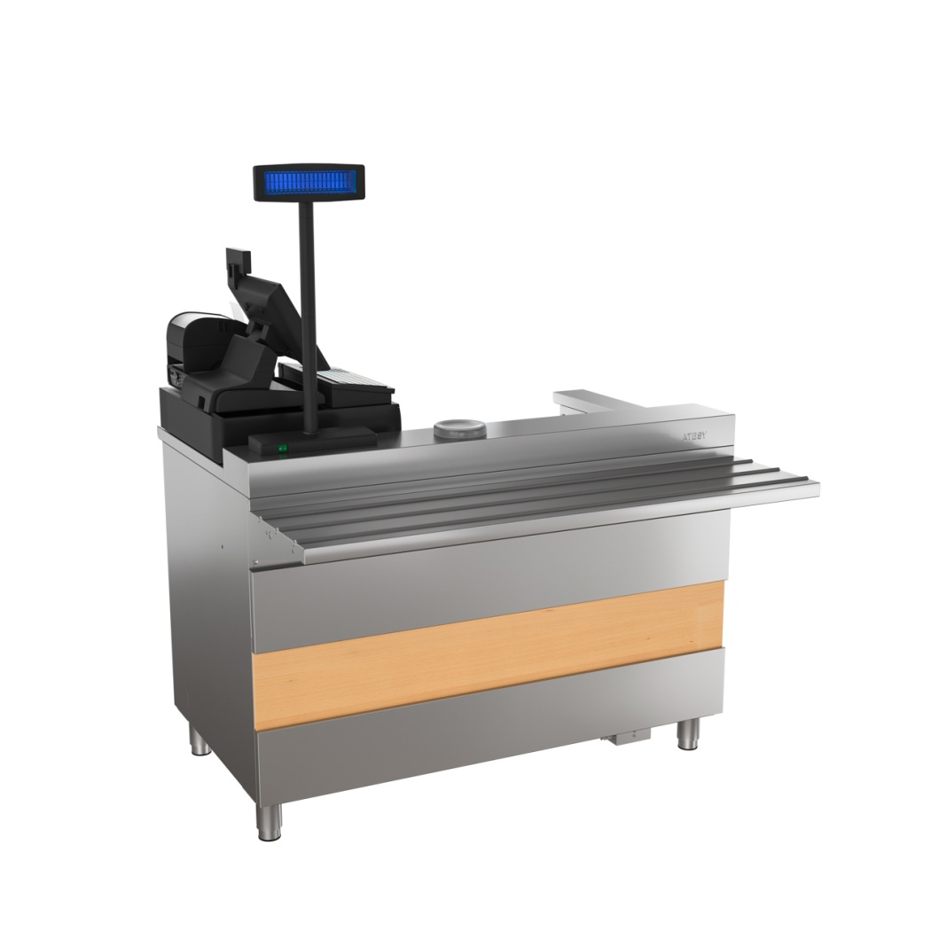
POWER DISTRIBUTION LINES
ATESY®
CASH DESK WITH ARMREST
КСП-1120-02
КСП-1200-02
completed with an electrical outlet
with right and left armrest
operates from the mains 220 V, 50 Hz
www.atesy.ru

Slide 48
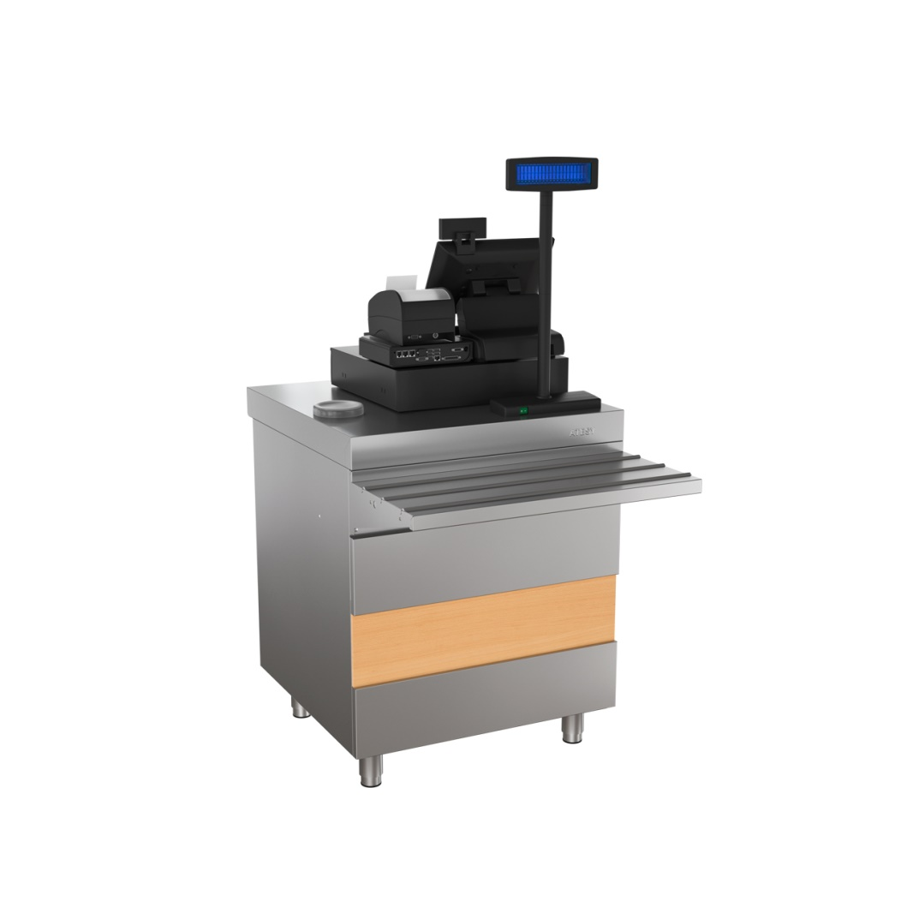
POWER DISTRIBUTION LINES
ATESY®
CASH DESK
КСУ- 700-02
completed with an electrical outlet
operates from the mains 220 V, 50 Hz
www.atesy.ru

Slide 49
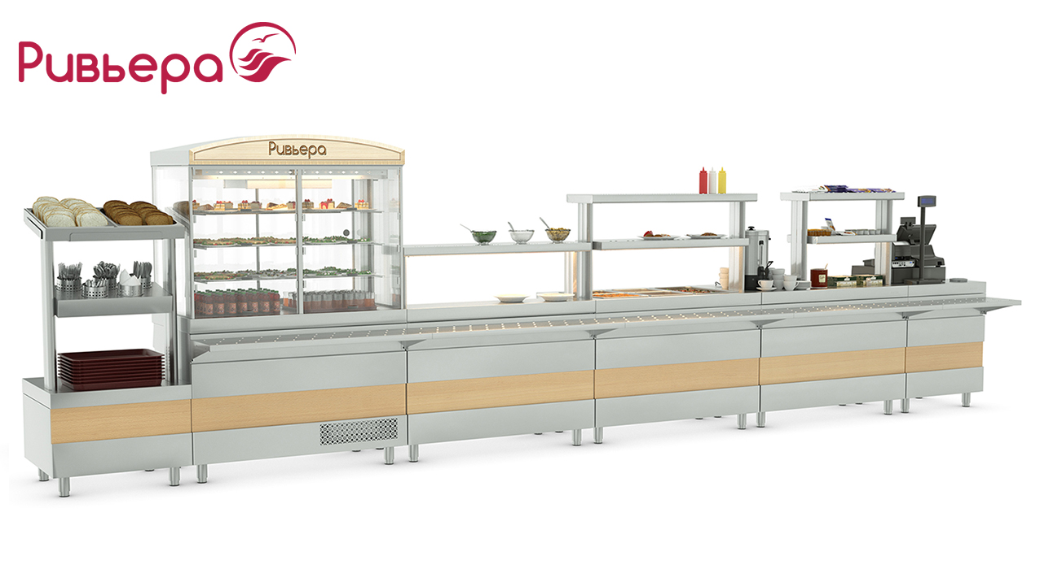
POWER DISTRIBUTION LINES
ATESY®
POWER DISTRIBUTION LINES
efficient use of space
more than 20 modules
standard delivery

Slide 50
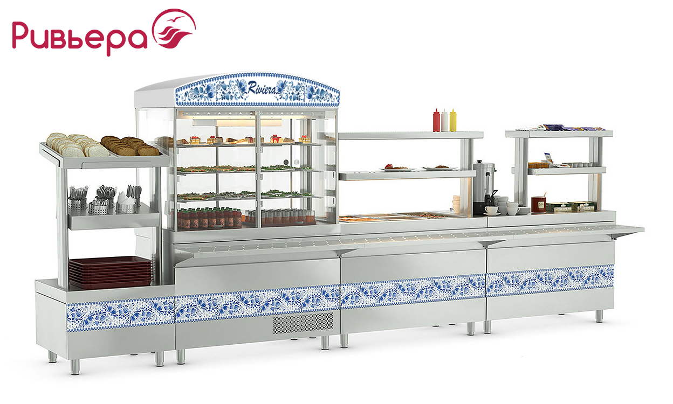
POWER DISTRIBUTION LINES
ATESY®
POWER DISTRIBUTION LINES
multiple options for decorating the appearance
simple and easily replaceable front panel in each module

Slide 51
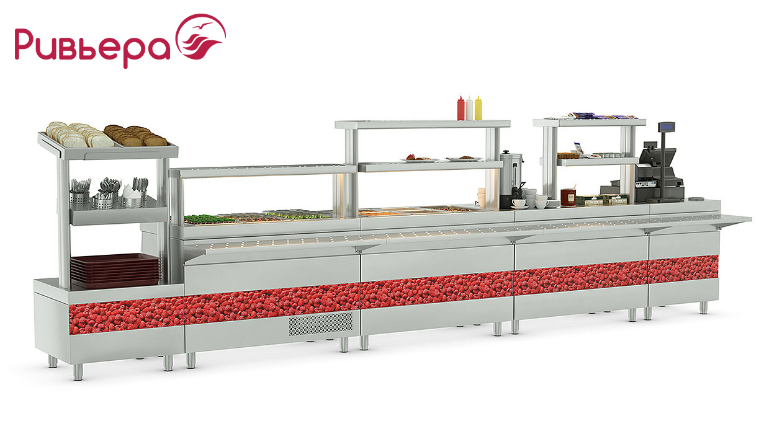
POWER DISTRIBUTION LINES
ATESY®
POWER DISTRIBUTION LINES
multiple options for decorating the appearance
simple and easily replaceable front panel in each module

Slide 52

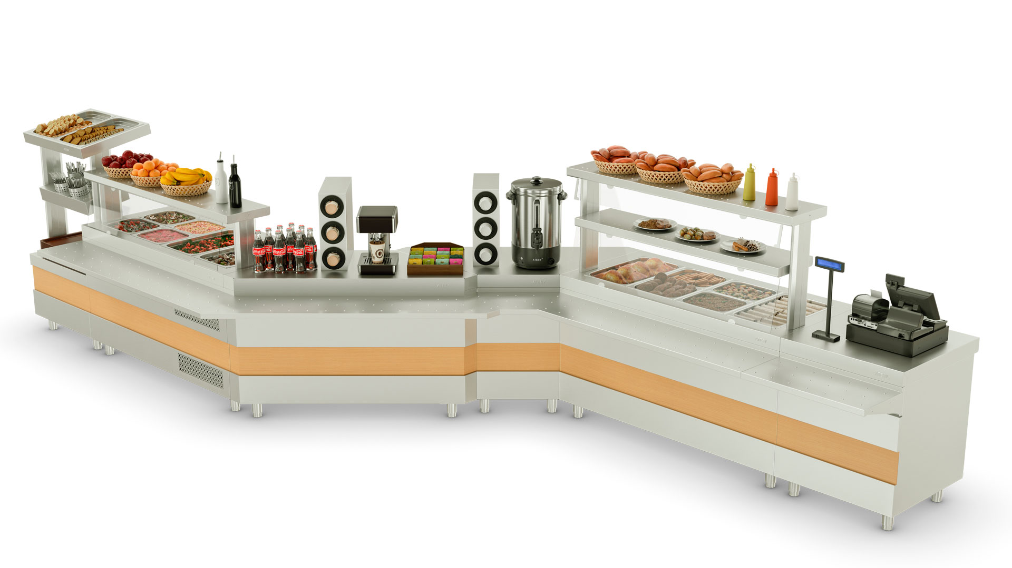
POWER DISTRIBUTION LINES
ATESY®
POWER DISTRIBUTION LINES
line with two rotary modules

Slide 53

POWER DISTRIBUTION LINES
ATESY®
POWER DISTRIBUTION LINES
line with internal rotary module 90⁰

Slide 54

POWER DISTRIBUTION LINES
ATESY®
POWER DISTRIBUTION LINES
line with external rotary module 90⁰

Slide 55

POWER DISTRIBUTION LINES
ATESY®
POWER DISTRIBUTION LINES
Cafe-buffet "Veloute" (Moscow)
EXAMPLES OF COMPLETED PROJECTS

Slide 56

POWER DISTRIBUTION LINES
ATESY®
POWER DISTRIBUTION LINES
Canteen of the plant “Helicopters of Russia” (Moscow region)
EXAMPLES OF COMPLETED PROJECTS

Slide 57


POWER DISTRIBUTION LINES
ATESY®
built-in power distribution line
advantage
in design
www.atesy.ru

Slide 58

POWER DISTRIBUTION LINES
ATESY®
unlimited number of decoration options
www.atesy.ru

Slide 59


POWER DISTRIBUTION LINES
ATESY®
Options for decorated modules
natural wood artificial stone and casing
www.atesy.ru

Slide 60
POWER DISTRIBUTION LINES
ATESY®
Composition of power distribution line modules
СП
Stand for cutlery
ХВ-1200
Refrigerated display case 1200, 1500 [mm]
ОС-1500
Refrigerated table 900, 1200, 1500 [mm]
ОП-1500
Cooling surface 900, 1200, 1500 [mm]
М1.2
2-burner hot food unit for first courses 1370 [mm]
М1.3С
Hot food unit for first courses for 3 electric soup pots 1370 [mm]
M2-1500
Steam hot food unit for second courses 900, 1200, 1500 [mm]
НС-940
Neutral table 940, 1240, 1370, 1540, 1670, 1840 [mm]
КСП
Cash Desk with armrest 1370 [mm]
ПМВШ
External rotary module
ПМВН
Internal rotary module
МПТ
Plate heating module
www.atesy.ru

Slide 61






POWER DISTRIBUTION LINES
ATESY®
POWER DISTRIBUTION LINES
Hot food unit
for second courses
Counter for cutlery and bread
Hot food unit for
first courses
Hot food unit for first
courses for electric
soup pots
Refrigerated table
Plate heating module

Slide 62


POWER DISTRIBUTION LINES
ATESY®
POWER DISTRIBUTION LINES
NEW
OPEN type cubic refrigerated display case

Slide 63

POWER DISTRIBUTION LINES
ATESY®
Stand for cutlery, СП-774-940-02
www.atesy.ru

Slide 64

POWER DISTRIBUTION LINES
ATESY®
Refrigerated display case ХВ-1200-1370-02
www.atesy.ru

Slide 65

POWER DISTRIBUTION LINES
ATESY®
2-burner hot food unit for first courses М1.2-1370-02
www.atesy.ru

Slide 66

POWER DISTRIBUTION LINES
ATESY®
Hot food unit for second courses М2-1500-1840-02-П
www.atesy.ru

Slide 67

POWER DISTRIBUTION LINES
ATESY®
Cash desk with armrest КСП-1370-02 (left/right)
www.atesy.ru

Slide 68

POWER DISTRIBUTION LINES
ATESY®
Finished objects
www.atesy.ru

Slide 69

POWER DISTRIBUTION LINES
ATESY®
Finished objects
www.atesy.ru

Slide 70

POWER DISTRIBUTION LINES
ATESY®
Finished objects
www.atesy.ru

Slide 71

POWER DISTRIBUTION LINES
ATESY®
Finished objects
www.atesy.ru

Slide 72

POWER DISTRIBUTION LINES
ATESY®
Finished objects
Cafe "LUCKY" (Moscow city)
www.atesy.ru

Slide 73






THERMAL EQUIPMENT
ATESY®
THERMAL EQUIPMENT. Heat line TRADITION
stylish modern design
the best combination of price, quality and functionality
Gastronorm ovens GN-2/1
ЭПШЧ-9-4-16
ЭПШЧ-9-6-23
ЭПЧ-9-6-17
ЭПЧ-9-2-6
ЭПЧ-9-4-12

Slide 74





THERMAL EQUIPMENT
ATESY®
THERMAL EQUIPMENT. Heat line TRADITION
FRYER
Hot food unit for second courses
ELECTRIC FRYING PAN with lifting bowl
ELECTRIC FRYING PAN
NEUTRAL TABLE

Slide 75



THERMAL EQUIPMENT
ATESY®
THERMAL EQUIPMENT. Food kettles TRADITION
250 liters
100 liters
160 liters
Food-cooking boiler АКПЭ-100-2.1
Food-cooking boiler АКПЭ-160-2.1
Food-cooking boiler АКПЭ-250-2.1

Slide 76



THERMAL EQUIPMENT
ATESY®
THERMAL EQUIPMENT. Cabinet ovens ЭШВ
classic version
variability of capacity
Cabinet oven ЭШВ-3
Cabinet oven ЭШВ-2
Cabinet oven
ЭШВ-1

Slide 77



THERMAL EQUIPMENT
ATESY®
THERMAL EQUIPMENT. Water heaters FOUNTAIN
capacity:
- 25 liters/hour
- 50 liters/hour
- 100 liters/hour
100% boiling water preparation
water heater
АКНЭ-25 FOUNTAIN
Water heater
АКНЭ-50 FOUNTAIN
Water heater
АКНЭ-100 FOUNTAIN

Slide 78

THERMAL EQUIPMENT
ATESY®
THERMAL EQUIPMENT. Water heaters SAMSON
Continuous water heater with boiling water storage unit "Samson"
100% boiled water
always hot boiling water 94º
maximum capacity 210 cups per hour

Slide 79

THERMAL EQUIPMENT
ATESY®
Samson water heater solves these problems
Boiling water generator
boiling of raw water to 100 ° C
Digital indication of the temperature of boiling water
Setting of the boiling water temperature
automatically maintains the set temperature in the boiling water storage unit
Emergency drain
raw water is discharged into the sewer when the automation fails
Boiling water storage unit
supports water temperature up to 99 ° C
Drip-catcher
eliminates the access of boiling water to the countertop

Slide 80


ELECTROMECHANICAL EQUIPMENT
ATESY®
ELECTROMECHANICAL EQUIPMENT. Bread cutter JANISSARY
capacity up to 300 loaves per hour
cuts both "daily" and fresh bread
high level of personal injury protection
stainless or painted steel case
Bread cutter AXM-300A JANISSARY painted
Bread cutter AXM-300A JANISSARY

Slide 81

ELECTROMECHANICAL EQUIPMENT
ATESY®
Conveyor for collecting of dirty dishes КАЮР-М
modular layout system
the maximum length is 20 meters
fully stainless steel
automatic system shutdown in case of overload

Slide 82




Equipment for disinfection
ATESY®
EQUIPMENT FOR DISINFECTION AND CLEANING.
Sterilizers for knives СТУ
Equipped with a grid-holder and a magnetic strip for knives
18 knives
36 knives

Slide 83


Equipment for bakeries
ATESY®
EQUIPMENT FOR BAKERIES. Flour sifter CASCADE
capacity 150 kg / hour
carefully sifts and
oxygenates the flour
equipped with a magnetic separation system - metal particle capture
Flour cart
Flour sifter CASCADE

Slide 84




Fast food equipment
ATESY®
FAST FOOD EQUIPMENT. Shawarma and contact grills
smooth or grooved surfaces
one- and two-section
stainless steel or galvanized housing
manual or electric drive
griddle plates Maestro, Tavern
gas and electric installations Shawarma

Slide 85


Fast food equipment
ATESY®
FAST FOOD EQUIPMENT. Meat pasty makers and fryers
one-and two-section fryers
meat pasty makers of various sizes and capacity
fryers
meat pasty makers

Slide 86


Fast food equipment
ATESY®
FAST FOOD EQUIPMENT. Pancake machines
The frying surface made of heat-resistant cast iron guarantees high-quality and uniform frying of pancakes over the entire surface
The frying surface made of heat-resistant cast iron has high non-stick properties and resistance to mechanical damage
Enlarged burners with a diameter of 400 mm allow you to cook large pancakes with filling
The edges of the burners are rounded
single-burner
two-burner

Slide 87
Fast food equipment
ATESY®
FAST FOOD EQUIPMENT. Donutmakers GULF STREAM
updated dispenser
donuts of the correct shape with any thickness of the dough
the same mass of doughnuts
works on doughnut mixes
(Tegral Ringo Type)
donutmakers Gulf Stream

Slide 88


Fast food equipment
ATESY®
FAST FOOD EQUIPMENT. Devices for the preparation of cheese and curd balls QUARKINI
Control unit
Dough dispenser
Capacity up to 500 pieces per hour the amount may vary, depending on the formulation and the production technology.
Mobility
thanks to its compact size - 770 x 515 mm, the device can be placed using a minimum area.
Easy to operate
Does not require special staff qualifications
Easy to maintain
All elements of the device are easily disassembled and washed after operation
Tray for layout
The device was developed and patented by ATESY company
Deep-frying vat
Notes:
88

Slide 89

Fast food equipment
ATESY®
FAST FOOD EQUIPMENT. Hot storage cabinet for pasty and hot dogs FIOLENT
Smooth temperature control inside the cabinet
The convection of warm air provides fast and
uniform heating
Easy-to-remove cassette
made of stainless steel for
the placement of product packages
The door is equipped with
light panel (lightbox) for
placement of promotional
image
Notes:
89

Slide 90


Fast food equipment
ATESY®
FAST FOOD EQUIPMENT. Grills for chickens COMMANDER
electric
gas
skewer grills for chickens Commander
carousel grills for chickens Commander

Slide 91



Fast food equipment
ATESY®
FAST FOOD EQUIPMENT. Grills and showcases for chickens COMMANDER
for 8 chickens
for 12 chickens
for 18 chickens
thermal display case for chickens
Commander
carousel grill for chickens
Commander

Slide 92




Ready-made solutions for business
ATESY®
READY-MADE SOLUTIONS FOR BUSINESS.
Hot dog station BAVARIA 1235 mm
it will fit seamlessly into any gas station
stationary or street trading
it is equipped with everything necessary for cooking hot dogs:
Roller grill
for sausages
Грати-5/500
Grill
SALAMANDER
ГСЛ-1-400.300-01
Contact grill
Maestro
ГК-1/1.55Р

Slide 93



Ready-made solutions for business
ATESY®
READY-MADE SOLUTIONS FOR BUSINESS.
Station for burgers and hot dogs BAVARIA 1235 mm
it will fit seamlessly into any gas station
stationary or street trading
completeв with everything you need:
Combi grill
ARBAT
КГ-7.3-570-01
Contact grill
Maestro
ГК-1/1.55Р

Slide 94

Ready-made solutions for business
ATESY®
READY-MADE SOLUTIONS FOR BUSINESS.
Station for burgers and hot dogs BAVARIA 900 mm
it will fit seamlessly into any gas station
stationary or street trading
completeв with everything you need:
Combi grill
ARBAT
КГ-7.3-570-01
Contact grill
Maestro
ГК-1/1.55Р

Slide 95


Ready-made solutions for business
ATESY®
READY-MADE SOLUTIONS FOR BUSINESS.
Station for burgers and hot dogs BAVARIA plus 900 mm
it will fit seamlessly into any gas station
stationary or street trading
completeв with everything you need:
Combi grill
ARBAT
КГ-7.3-570-01
Roller grill for sausages
Грати-5.440-02
Contact grill
Maestro
ГК-1/1.55Р

Slide 96

Ready-made solutions for business
ATESY®
READY-MADE SOLUTIONS FOR BUSINESS.
Pancake station GOURMAND
Frying surface made of heat-resistant cast iron
Enlarged burners with a diameter of 400 mm
The edges of the burners are rounded
Protective glass protects the buyer from the cooking process
Built-in пastronorm holders for storing fillings and dough
Built-in drawer
for easy storage of inventory
БС-2.400-1350.750-02

Slide 97

Ready-made solutions for business
ATESY®
READY-MADE SOLUTIONS FOR BUSINESS.
Pancake station GOURMAND
Protective glass protects the buyer from
cooking process
Lightbox shapes the station into
unique appearance
High non-stick properties
High-quality and uniform roasting
of pancakes all over the surface
Wooden turner for dough distribution
included
Wooden turner for turning
of pancakes included
БС-2.400-1350.750-02

Slide 98

Ready-made solutions for business
ATESY®
READY-MADE SOLUTIONS FOR BUSINESS.
Coffee station SUMATRA
The housing is made of corrosion resistant stainless steel
The station's countertop is made of artificial stone
Two dispensers for glasses and two niches for lids
Special cabinet for waste collection with a container included
Spacious cabinet with hinged doors for storing water, dishes, coffee and ingredients

Slide 99

Ready-made solutions for business
ATESY®
READY-MADE SOLUTIONS FOR BUSINESS.
Coffee station SUMATRA
It is intended for complex equipment of the workplace preparation and sale of coffee
The station can be used both for stationary, street trade, and for placement in the gas station format

Slide 100



Ready-made solutions for business
ATESY®
READY-MADE SOLUTIONS FOR BUSINESS. Equipment for burger joints
Hot food unit for French fries МФ-655/3
Hot food unit and display case for burgers ВМБ-750/4

Slide 101


Ready-made solutions for business
ATESY®
READY-MADE SOLUTIONS FOR BUSINESS. Equipment for burger joints
Table-stand with dispensers for glasses
СТД-2/1200-2 compartment
Food court litter bin УФ-610/220

Slide 102

Ready-made solutions for business
ATESY®
Waste collection station for food courts
100% stainless steel
ergonomic design
operation indoors
and outdoors

Slide 103




Ready-made solutions for business
ATESY®
Waste collection station solves these problems
Convenient flap opening handle
Limiters for trays
Roll-out container with bag retainer
Special funnel that eliminates the spillage of garbage

Slide 104


Ready-made solutions for business
ATESY®
1. With pendulum-type opening of the garbage can flap

Slide 105


Ready-made solutions for business
ATESY®
2. With lever-type opening of the garbage can flap

Slide 106


Ready-made solutions for business
ATESY®
3. With pedal-type opening of the garbage can flap

Slide 107


Ready-made solutions for business
ATESY®
4. With touch-sensitive opening of the garbage can flap

Slide 108

Automatic equipment
ATESY®
Egg cooker ЯВА-4-01
■ Automation of the egg cooking process
■ 3 built-in cooking modes:
- soft-boiled
- coddled
- hard-boiled
■ Timer to display the countdown
■ Beep at the end of cooking
■ Indication of low water level and overheating
■ Possibility to program cooking modes
■ Decorative shelf-stand made of natural beech included
■ Cooking tweezers and a set of stands for cooked eggs included
The device was developed and patented by ATESY company
Size: 430 x 535 x 520 mm
Voltage: 220 V
Power: 2 kW
Capacity: 4 eggs

Slide 109



Ventilation equipment
ATESY®
modular construction
VENTILATION EQUIPMENT
Range hood ЗВН-1
Range hood ЗВН-2
Island hood ЗВО
Supply and exhaust hood МВО

Slide 110








NEUTRAL EQUIPMENT
ATESY®
NEUTRAL EQUIPMENT OF THE 2-ND GENERATION
www.atesy.ru

Slide 111
NEUTRAL EQUIPMENT
ATESY®
series | Material of the main structural elements | Frame material | Frame cross section
BUDGET | AISI 430 0.7...0.8 mm thick sheet | Galvanized steel 1.2 mm thick sheet
STANDARD | AISI 304 / AISI 430 0.8 mm thick sheet | Galvanized steel 1.2 mm thick sheet AISI 430 0.8 mm thick sheet
PRESTIGE | AISI 304 / AISI 430 0.8 mm thick sheet | AISI 201 1.5 mm thick profile
LUX | AISI 304 0.8 mm thick sheet | AISI 304 1.5 mm thick profile
www.atesy.ru

Slide 112

NEUTRAL EQUIPMENT
ATESY®
NEUTRAL EQUIPMENT
construction
modular
budget AISI 430
Vat ВСМ-Б-1.430-02
Vat ВСМ-Б-2.430-02
Vat ВСМ-Б-3.430-02
frame - galvanized steel
standard AISI 304
Vat ВСМ-С-1.430-02
Vat ВСМ-С-2.430-02
Vat ВСМ-С-3.430-02
frame - galvanized steel

Slide 113

NEUTRAL EQUIPMENT
ATESY®
NEUTRAL EQUIPMENT
construction
modular
budget AISI 430
Vat with a table ВСМС-Б-1.430-1010.530-02
Vat with a table ВСМС-Б-1.530-1210.630-02
Vat with a table ВСМС-Б-1.600-1350.700-02
Vat with a table ВСМС-Б-1.700-1550.800-02
frame - galvanized steel
standard AISI 304
Vat with a table ВСМС-С-1.430-1010.530-02
Vat with a table ВСМС-С-1.530-1210.630-02
Vat with a table ВСМС-С-1.600-1350.700-02
Vat with table ВСМС-С-1.700-1550.800-02
frame - galvanized steel

Slide 114

NEUTRAL EQUIPMENT
ATESY®
NEUTRAL EQUIPMENT
construction
modular
budget AISI 430
Vat ВСМ-Б-1.430-1-02
Vat ВСМ-Б-2.430-1-02
Vat ВСМ-Б-3.430-1-02
frame - galvanized steel
standard AISI 304
Vat ВСМ-С-1.430-1-02
Vat ВСМ-С-2.430-1-02
Vat ВСМ-С-3.430-1-02
frame - galvanized steel

Slide 115

NEUTRAL EQUIPMENT
ATESY®
NEUTRAL EQUIPMENT
construction
modular
standard AISI 304
Full-length vat ВСМЦ-С-1.500.400-1-02
Full-length vat ВСМЦ-С-2.500.400-1-02
Full-length vat with table
ВСМЦС-С-1Л.500.400-1200.600-1-02
Full-length vat with table
ВСМЦС-С-1П.500.400-1200.600-1-02
frame - galvanized steel

Slide 116

NEUTRAL EQUIPMENT
ATESY®
NEUTRAL EQUIPMENT
construction
modular
prestige AISI 304
Full-length vat ВСМЦ-П-1.500.400-1-02
Full-length vat ВСМЦ-П-2.500.400-1-02
Full-length vat with table
ВСМЦС-П-1Л.500.400-1200.600-1-02
Full-length vat with table
ВСМЦС-П-1П.500.400-1200.600-1-02
frame - stainless pipe

Slide 117

NEUTRAL EQUIPMENT
ATESY®
NEUTRAL EQUIPMENT
construction
modular
standard AISI 430
Table СР-Б- 600.600-02
frame - galvanized steel
with a board
without a board

Slide 118

NEUTRAL EQUIPMENT
ATESY®
NEUTRAL EQUIPMENT
construction
modular
standard AISI 430
Table СР-С-1- 600.600-02
frame - galvanized steel
with a board
without a board

Slide 119

NEUTRAL EQUIPMENT
ATESY®
NEUTRAL EQUIPMENT
construction
modular
standard AISI 430
Table СР-С- 600.600-02-ПСОц
Frame and shelf - galvanized steel
with a board
without a board

Slide 120

NEUTRAL EQUIPMENT
ATESY®
NEUTRAL EQUIPMENT
construction
modular
standard AISI 430
Table СР-С-2- 600.600-02
Table СР-С-2- 700.700-02
Table СР-С-2- 800.800-02
frame - galvanized steel

Slide 121

NEUTRAL EQUIPMENT
ATESY®
NEUTRAL EQUIPMENT
construction
modular
standard AISI 430
Waste table СРО-С-1П- 950.600-02
frame - galvanized steel

Slide 122

NEUTRAL EQUIPMENT
ATESY®
NEUTRAL EQUIPMENT
construction
modular
standard AISI 304
Vegetable table СО-С-1-1200.800-02
Vegetable table СО-С-2-1500.800-02
frame - galvanized steel

Slide 123

NEUTRAL EQUIPMENT
ATESY®
NEUTRAL EQUIPMENT
construction
modular
standard AISI 304
Meat table СМ-С-1200.600-02
Meat table СМ-С-1200.700-02
Meat table СМ-С-1200.800-02
frame - galvanized steel

Slide 124

NEUTRAL EQUIPMENT
ATESY®
NEUTRAL EQUIPMENT
construction
modular
prestige AISI 430
Table СР-П- 600.600-02
frame - stainless pipe
with a board
without a board

Slide 125

NEUTRAL EQUIPMENT
ATESY®
NEUTRAL EQUIPMENT
construction
modular
prestige glued beech
Confectionery table СК-П-1-1500.700-02
Confectionery table СК-П-1-1500.800-02
Confectionery table СК-П-1-1800.700-02
Confectionery table СК-П-1-1800.800-02
frame - stainless pipe

Slide 126

NEUTRAL EQUIPMENT
ATESY®
NEUTRAL EQUIPMENT
construction
modular
Lux AISI 304
Table СР-Л- 600.600-02
frame - stainless steel quartz tube
with a board
without a board

Slide 127



NEUTRAL EQUIPMENT
ATESY®
NEUTRAL EQUIPMENT. Technological tables
ST compartment
СT with cells
СTM compartment (with sink)
СTM compartment (with sink)

Slide 128

NEUTRAL EQUIPMENT
ATESY®
NEUTRAL EQUIPMENT
construction
modular
standard AISI 430
Rack СТК-С- 600.400.1800-02
frame - galvanized steel

Slide 129

NEUTRAL EQUIPMENT
ATESY®
NEUTRAL EQUIPMENT
construction
modular
prestige AISI 430
Rack СТК-П- 600.400.1600-02
frame - stainless pipe

Slide 130

NEUTRAL EQUIPMENT
ATESY®
NEUTRAL EQUIPMENT
construction
modular
budget
Rack for plates and glasses СКТС-Б- 650-02
Rack for plates and glasses СКТС-Б- 900-02
Rack for plates and glasses СКТС-Б-1200-02
Rack for plates СКТ-Б- 650-02
Rack for plates СКТ-Б- 900-02
Rack for plates СКТ-Б-1200-02
shelves- painted steel, frame - galvanized steel
Standard AISI304 - shelves / AISI430 - frame
Rack for plates СКТ-С- 600-02-Н
Rack for plates СКТ-С- 950-02-Н
Rack for plates СКТ-С-1200-02-Н
Rack for plates СКТ-С-1500-02-Н

Slide 131








NEUTRAL EQUIPMENT
ATESY®
NEUTRAL EQUIPMENT. Shelves
ПНК
ПЗК-Р
ПЗК-К
ППК
ПЗТ-Р
ПЗТ-К
ПКТ
ПКД-К
ПКД
ПКК

Slide 132






NEUTRAL EQUIPMENT
ATESY®
NEUTRAL EQUIPMENT. Washstands
ВРК-330
ВРК-400
ВРК-500
ВР-600
ВРН-600 с/п
ВРН-600 б/п

Slide 133



NEUTRAL EQUIPMENT
ATESY®
NEUTRAL EQUIPMENT. Cutting decks
КР-500/800
КР-500/700

Slide 134



NEUTRAL EQUIPMENT
ATESY®
NEUTRAL EQUIPMENT. Cutting boards.

Slide 135








NEUTRAL EQUIPMENT
ATESY®
NEUTRAL EQUIPMENT. Trolleys
Flour trolley TM
Serving trolley TC-2
Trolley for plates TT-2
Cargo trolley ТГР
Serving trolley TC-3
Trolley for vegetables TO
Trolley for plates TT-3
Trolley for collecting dishes ТСП
Trolley for gastronorm pans

Slide 136




NEUTRAL EQUIPMENT
ATESY®
NEUTRAL EQUIPMENT. Pins
for baking sheets
for baking plates
for gastronorm pans
for trays

Slide 137

NEUTRAL EQUIPMENT
ATESY®
NEUTRAL EQUIPMENT. Pins
for trays
in the format of a restaurant
in a hypermarket

Slide 138



NEUTRAL EQUIPMENT
ATESY®
NEUTRAL EQUIPMENT. Cabinets
Closed kitchen cabinet
ШЗК
Closed cabinet for bread
ШЗХ
Wardrobe
ШО

Slide 139


NEUTRAL EQUIPMENT
ATESY®
NEUTRAL EQUIPMENT. Stands
Stand for kitchen
inventory ПКИ
Stand for electromechanical
equipment ПДЭ

